Slide 1
Honeywell
APM
May 2024
Admin Training – Asset Performance Management
Honeywell Internal

Slide 2

Safety and code of conduct
Please review all Emergency exits; be alert for Alarm signals;
Please follow the safety procedures of your workplace;
Please switch off or silence your mobile;
Please have one conversation only;
Please speak up, ask questions;
Please follow the COVID guidelines of your workplace;

Slide 3
Agenda
Module 1:
Data Source configuration
OPC DA data source configuration
OPC HDA data source configuration
PHDAPI data source configuration
UniSim data source configuration
Data source status check
Model Configuration using existing models-UI Approach
Asset Configuration
Static Attribute Value Update
Dynamic Attribute Tag Mapping
Asset limit update/Property update
Asset Model Mapping and model scheduling
Variable Monitoring Configuration
Graphics linkage to asset
Creating default asset trends
Asset links configuration
Model Configuration using existing models-BCT Approach
Asset Configuration
Static Attribute Value Update
Dynamic Attribute Tag Mapping
Asset limit update/Property update
Asset Model Mapping and model scheduling

Slide 4
Agenda (Cont..)
Module 2:
Building new models-UI Approach
Asset class configuration
Asset type configuration
Attribute type configuration
Calculation model configuration
Fault-Symptom model configuration
Building new models-BCT Approach
Asset class configuration
Asset type configuration
Attribute type configuration
Attribute properties configuration
Calculation model configuration
Fault-Symptom model configuration
Graphics changes-HMI Web builder
Graphics toolbars
Adding new tags/modifying existing tag mappings
Updating shapes
Saving and publishing graphics
Graphics location
Asset hierarchy Updates

Slide 5
Agenda (Cont..)
Module 3:
Thermo stream models
Thermo streams export and import procedure from UniSim
Thermo stream configuration
UniSim models
UniSim model creation
UniSim-UAS tag mapping
UniSim asset and error codes
Embedded PHD
PHD tag configuration
PHD monitoring
Asset Metrics
Application Monitoring
Service logs
MES log viewer
AM Service stop/start
PHD Cold start/stop
Server restart procedure
Security Configuration
Creating new roles
Creating new scopes
Adding/removing users from roles

Slide 6
Module1
DATA SOURCE CONFIGURATION

Slide 7
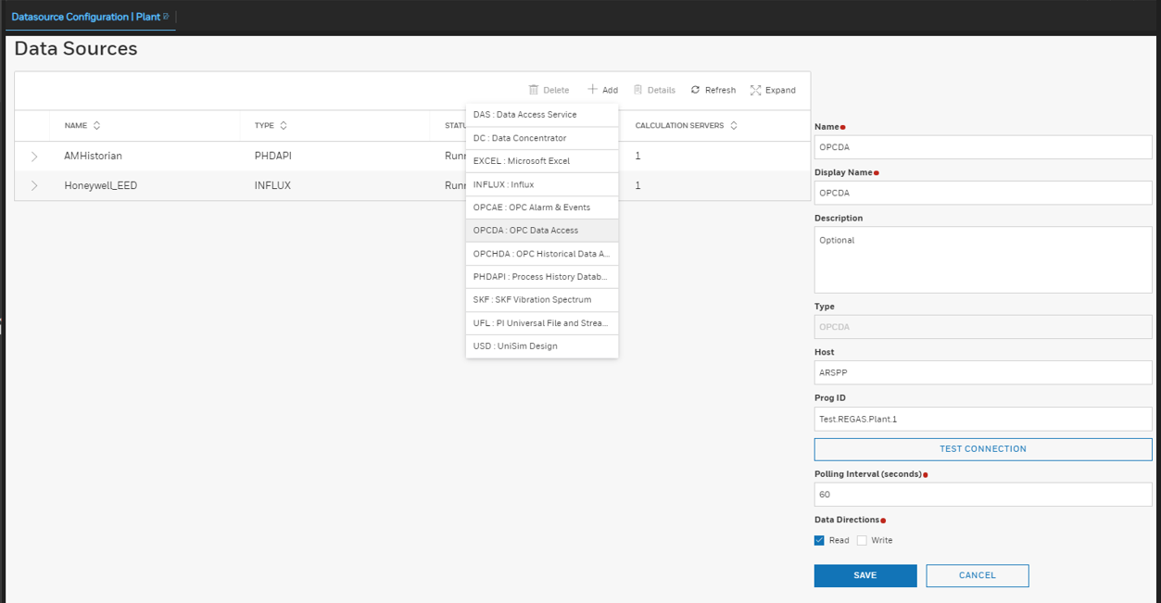
OPC DA DATA SOURCE CONFIGURATION
OPC DA Data Sources
“OPCDA” data source is used to read near real-time data from the OPC Generator.
“PHDDA” data source is used to fetch stored input/output/cleansed data from local embedded PHD server.
To configure a OPC DA data source, perform the following steps:
In the Contents Tree choose Datasources in Configuration Tab.
In the Data Source page, click +Add to list down the data source addition to create OPCDA data source.
In the Data Source Name & Display Name box, type a name for the data source.
In the Host box, type the machine name where the external OPC Server is running.
In the Prog ID box, type the DA program ID of the OPC server.
In the Polling Interval box, type the sampling rate for the data source (between 2 and 60 seconds).
Select data directions. Select “Read” if the data is only read from OPC server. If data needs to be written back to the OPC server, select “Write” as well.
Click Test Connection to verify the connection to the data source. A message in the bottom of the screen indicates if the connection has succeeded or failed.
Click Save to save the external data source configuration.

Slide 8
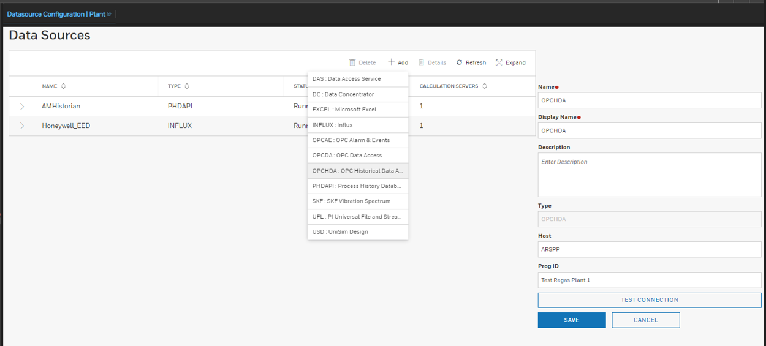
OPC HDA DATA SOURCE CONFIGURATION
OPC HDA Data Source :
To configure a OPC HDA data source, perform the following steps :
In the Contents Tree choose Datasources in Configuration Tab.
In the Data Source page, click +Add to list down the data source addition to create OPCHDA data source.
In the Data Source Name & Display Name box, type a name for the data source.
In the Host box, type the machine name where the external OPC Server is running.
In the Prog ID box, type the HDA program ID of the of the OPC server.
Click Test Connection to verify the connection to the data source. A message in the bottom of the screen indicates if the connection has succeeded or failed.
Click Save to save the data source configuration.

Slide 9
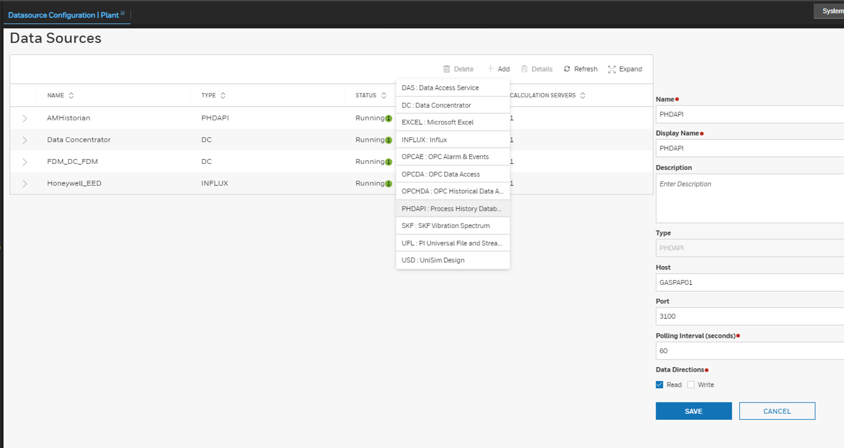
PHDAPI DATA SOURCE CONFIGURATION
PHDAPI Data Source
PHDAPI data source is used to fetch historical data from PHD server.
AMHistorian is used to write data to EPHD.
To configure a PHDAPI data source, perform the following steps:
In the Contents Tree choose Datasources in Configuration Tab.
In the Data Source page, click +Add to list down the data source addition to create PHDAPI data source.
In the Data Source Name & Display Name box, type a name for the data source.
In the Host box, type the machine name where the Inbuilt Embedded Historian (EPHD) is running.
In the Port Number Box, type the Port Number of the EPHD API service. By default, it is 3100.
In the Polling Interval box, type the sampling rate for the data source (between 2 and 60 seconds).
Select data directions. Select “Read” if the data is only read from EPHD server. If data needs to be written back to the EPHD server, select “Write” as well.
Click Save to save the data source configuration.

Slide 10
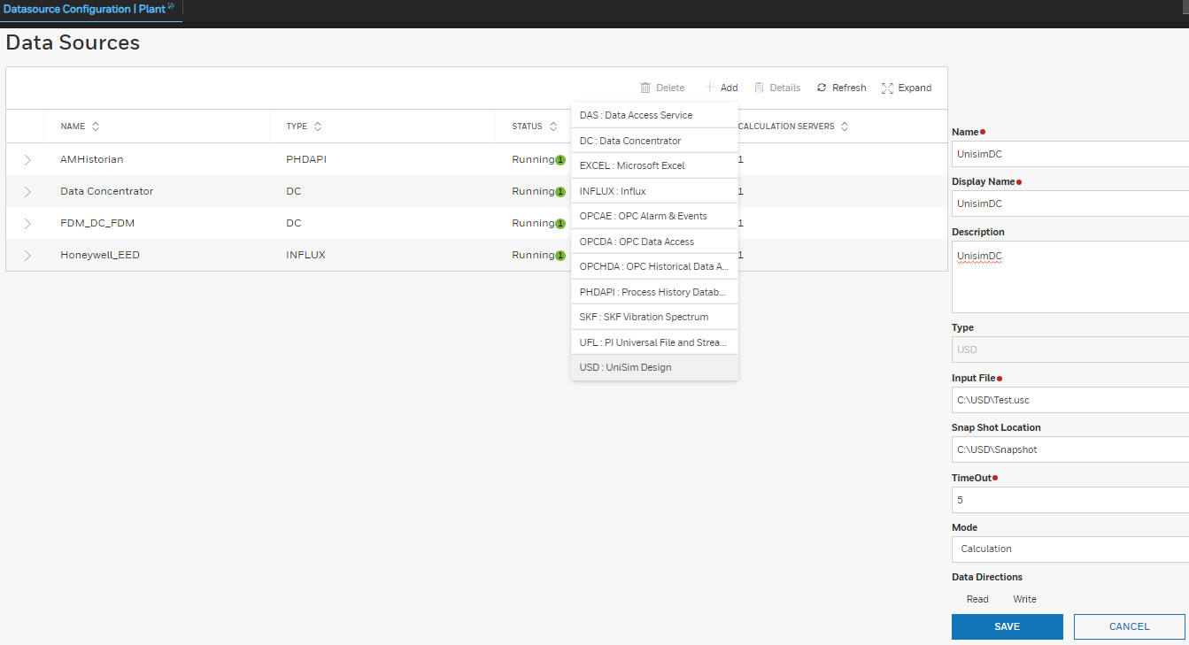
UNISIM DATA SOURCE CONFIGURATION
UniSim Data Sources
USD data source is used to push Input data from Sentinel server to Unisim and read the Output results from UniSim to Sentinel via Attribute Mapping.
To configure a USD data source, perform the following steps:
In the Contents Tree choose Datasources in the Configuration Tab.
In the Data Source page, click +Add to list down the data source addition to create USD data source.
In the Data Source Name & Display Name box, type a name for the data source.
In the Input File box, type the Location (full path) where the UniSim Model file is kept.
In the Snapshot Location Box, type the Location where the Snapshot Folder is kept. This snapshot folder can be used to generate snapshots of each Unisim model run provided USD Administrator license is available.
In the Timeout box, type the sampling rate for the data source. E.g., 5 Minutes.
Select mode as “Calculation”.
Click Save to save the data source configuration.

Slide 11
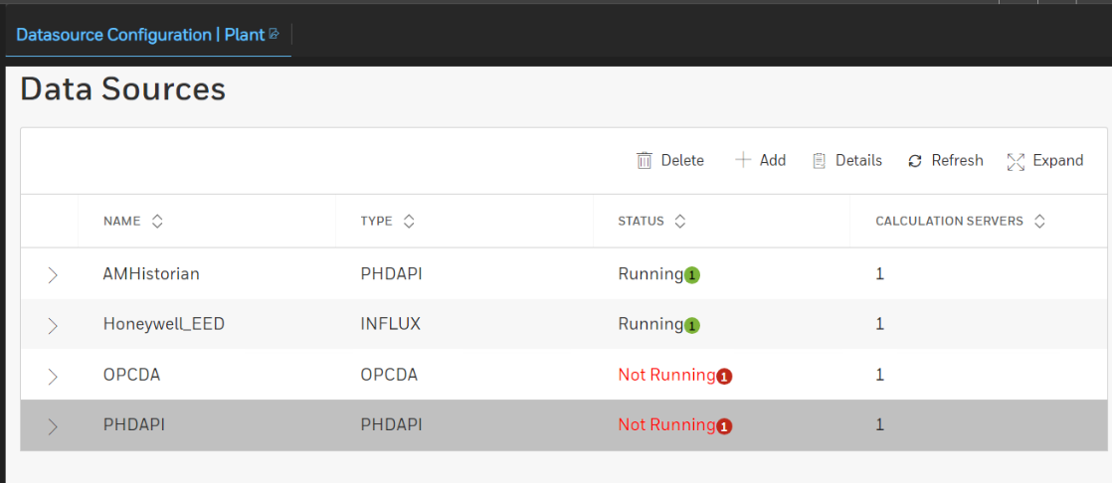
DATA SOURCE STATUS CHECK
To check the status of the interfaces and the UAS Application service, the Administrator user can go to Sentinel>Contents Tree> Datasources.
If the status of all data sources are “Running”, then it means the connectivity between the external machine and UAS server is up and running.
If the status of a data source is “Marginal”, then it means the connectivity between the external machine and UAS server is having a problem and UAS is trying to reconnect to the external machine.
If the status of a data source is “Not Running”, then it means the connectivity between the external machine and UAS server is broken.

Slide 12
Data Source Configuration Block Diagram
I
Data Source configuration
OPC DA data source configuration
1
PHDAPI data source configuration
2
UniSim data source configuration
3

Slide 13
Data Source Configuration Block Diagram
1
2
OPC DA data source configuration
PHDAPI data source configuration
1. Enter the following details:
Data Source Name
DisplayName
Host
ProgID
Polling interval as 60 s
1. Enter the following details:
Data Source Name
DisplayName
Host
Port (3100 is default)
Polling interval as 60 s
2. Click on Read check box
2. Click on Read check box
3. Click on Save
3. Click on Save
4. Click on TestConnection
4. Success
5. Error (Check the details in Step 1)
5. Success
6. Error (Check the details in Step 1)

Slide 14
Data Source Configuration Block Diagram
3
UniSim data source configuration
1. Enter the following details:
Data Source Name
DisplayName
Description
Input File
Snapshot Location
Timeout
Mode as “Calculation”
3. Click on Save
4. Success
5. Error (Check the details in Step 1)

Slide 15
Module1
MODEL CONFIGURATION USING EXISTING MODELS-UI APPROACH

Slide 16
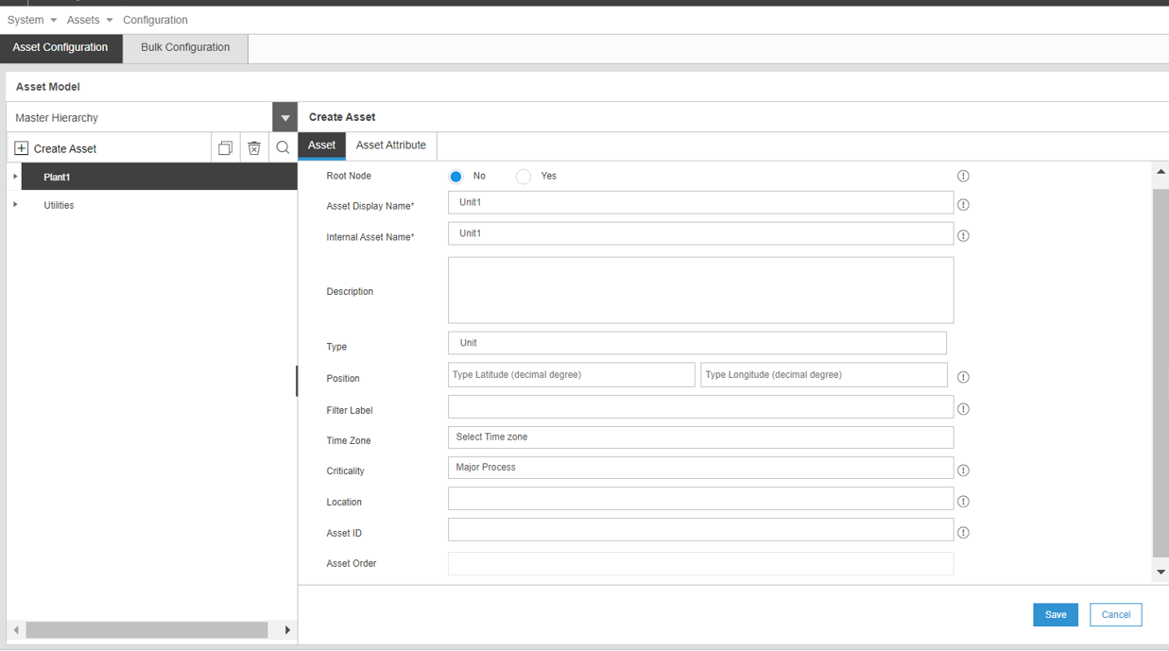
ASSET CONFIGURATION
Launch the UAS home page. Go to “Asset Configuration” in the Contents tree. In the new window page Select “Asset Configuration” tab.
In the tree view, select an existing asset and click on Create Asset. If no other assets are present, click on Create Asset. An asset called NEWASSET is added under the selected parent asset in the tree view after providing below information.
In the Asset Name box and Display Name box, type the name of the asset.
In the Asset Description box, type the description of the asset.
From the Asset Type drop-down list, select the required type.
Click the Criticality drop-down list and select the criticality value.
Note:
Configuration changes shall be done in the test server first and then migrated to production server using BCT after testing

Slide 17
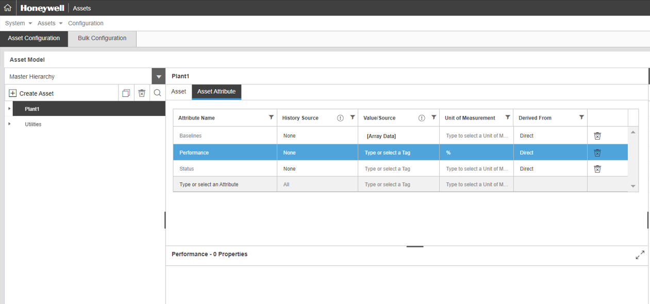
STATIC ATTRIBUTE VALUE UPDATE
Select on the Asset Attribute for the asset you created from the asset tree.
On the Asset Attribute pane, click the attribute you want to edit.
The details of the attribute are listed for the asset . From the last row add new attribute available from the dropdown.
Edit the value in the Value field.
Click Save to save the changes made to the attribute.

Slide 18
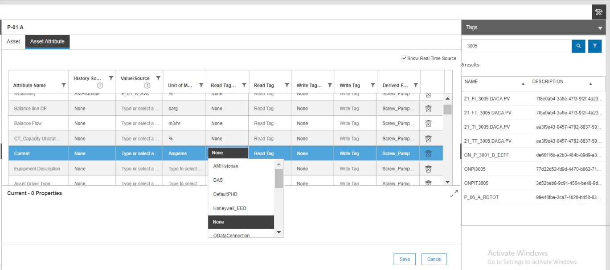
DYNAMIC ATTRIBUTE TAG MAPPING
On the right side select the tags from drop down option available in the top row header. Also enable the check box to show real time source.
Select the attribute for which PHD tag is to be mapped.
If attribute is reading from EPHD, select the Read Datasource from dropdown (PHDDA). This configuration is for real-time data reading from PHD server.
If attribute is writing to EPHD, select Write datasource from dropdown and provide write tag name.
Select the Historical datasource from dropdown (PHDHDA) and provide the tag name in tag name field. This enables trending functionality for attribute
Click Save. Read tag name is required only when real-time tag is different than history tag. Select read tag source and provide read tag name in this case.

Slide 19
DYNAMIC ATTRIBUTE TAG MAPPING
Rules to be considered
If Input tag is read from OPC Generator, read data source is OPCDA.
If Input tag is read from EPHD (cleansed data/output tag/intermediate tag), then the read data source is PHDDA.
If calculation output needs to be stored in EPHD, use only Historical data source. The data source to be selected is “AMHistorian” in the “Historical” data source section.
Configuration Scenarios:
Attribute needs input value from OPC Generator and it needs to be stored in EPHD:
Read datasource-OPCDA
Read tag name-OPC Generator tag name
Write datasource-
Write tag name-
Historical datasource-AMHistorian
Historical tag name-EHD tag name
Attribute needs cleansed input value from EPHD, and attribute needs to be trended:
Read datasource-PHDDA
Read tag name-EPHD tag name
Write datasource-
Write tag name-
Historical datasource-PHDHDA
Historical tag name-EHD tag name
Attribute needs to store calculation output values in EPHD, and attribute needs to be trended:
Read datasource-
Read tag name-
Write datasource-
Write tag name-
Historical datasource-AMHistorian
Historical tag name-EHD tag name

Slide 20
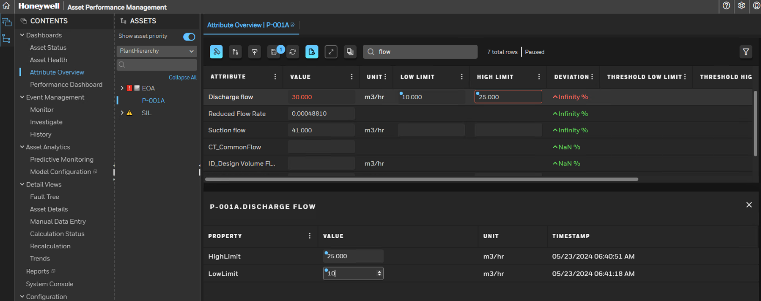
ASSET LIMIT UPDATE/PROPERTY UPDATE
Select an Asset from the “PlantHierarchy”.
Select Asset Attribute under Dashboards.
Double click on Attribute and the property window will open in bottom of the attribute pane.
Enter High and Low Limit values as applicable and click Save in the top of the attribute pane to save the new limits.

Slide 21
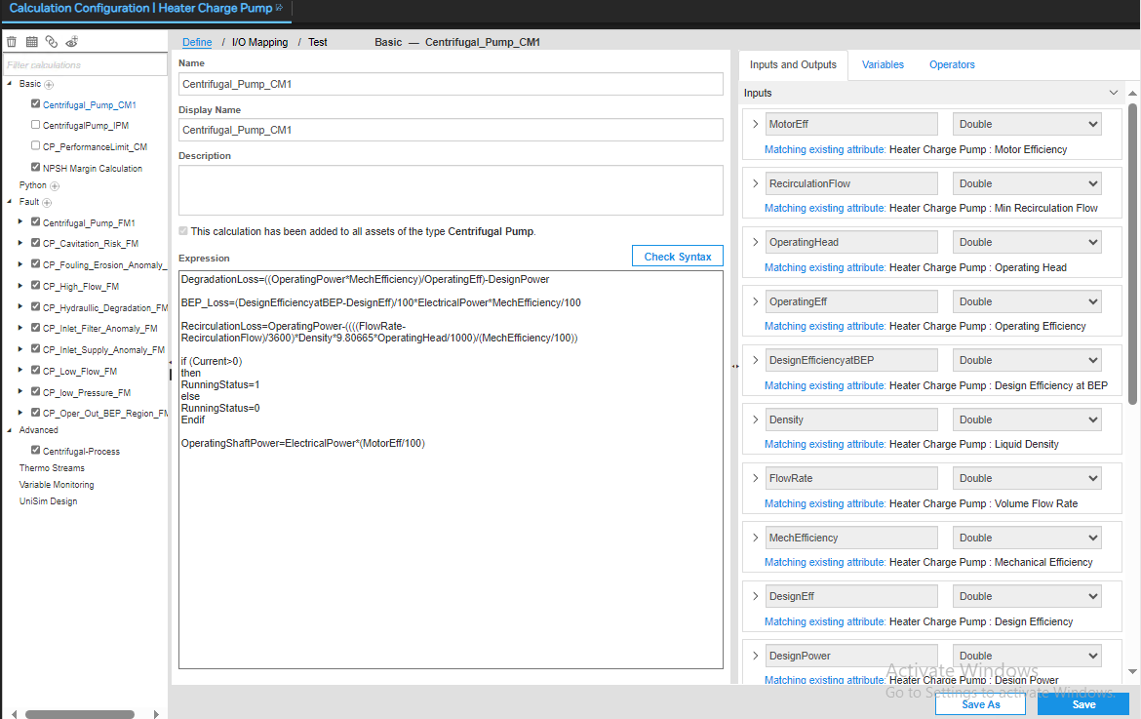
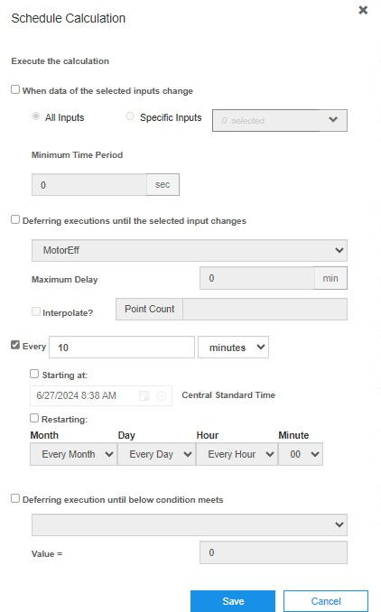
Asset Model Mapping and model scheduling
Navigate to “Calculation Configuration” menu.
Select all the calculation models in the calculation configuration page and click save.
Click on to open the schedule calculation window .
Update the schedule as per requirement and click save to save the results.

Slide 22
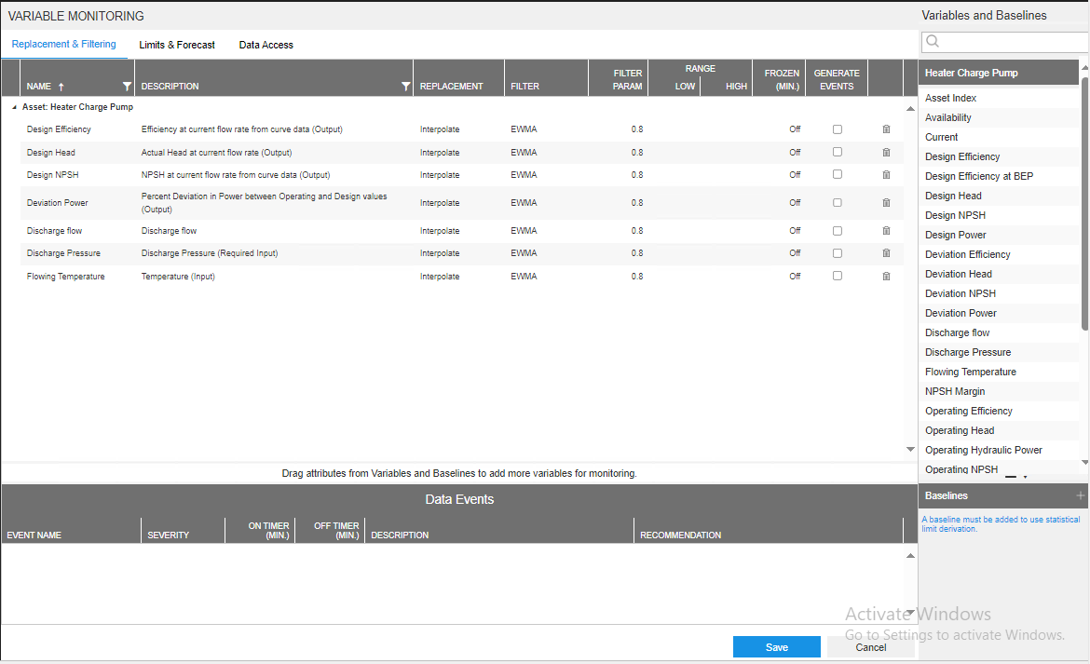
VARIABLE MONITORING CONFIGURATION
Go to Sentinel Dashboard, under Content expand configuration tab click on Variable monitoring.
Go to “Replacement & Filtering” tab.
Drag and drop the attribute from the right sidebar to the viewing pane. The attribute appears in the table.
In the Replacement column, select the replacement type for the bad quality data.
In the Filter column, select the filter type to use.
In the Filter Param column, type the value for the filter type.
In the Range Low column, type the low value threshold.
In the Range High column, type the high value threshold.
In the Frozen, type the number of minutes a value must remain the same before it is considered frozen/bad data.
In the Generate Events column, select the checkbox to create the related data events for the attribute.
Click Save.
To push the changes to the server, click Publish.

Slide 23
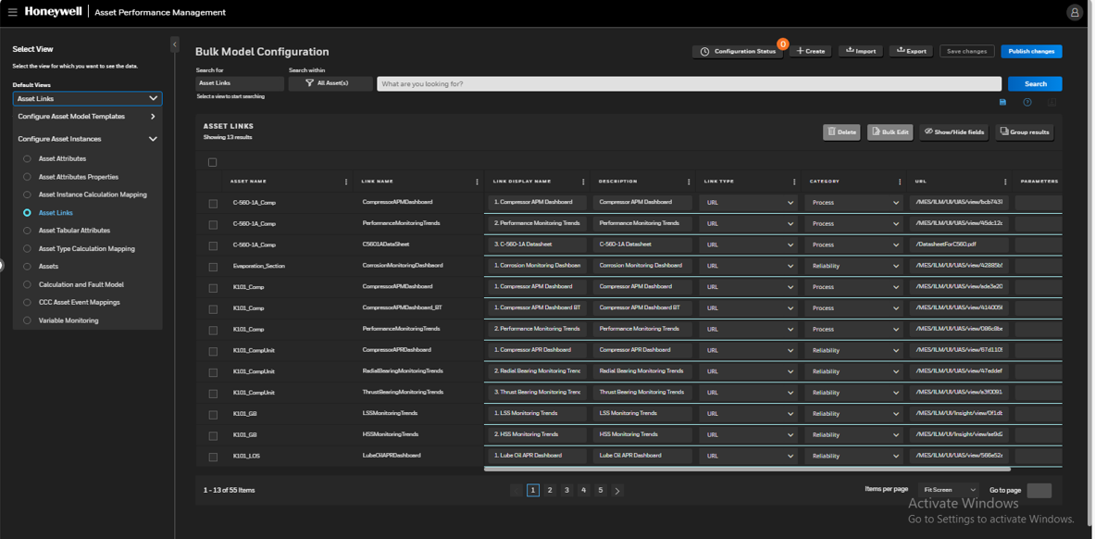
GRAPHICS LINKAGE TO ASSET
Navigate to Configuration studio and search for Asset Link.
Click on Create button for new Asset Links or existing link can be modified by searching it.
Provide link name, display name and description.
Select link type and category from drop down, enter Asset Link URL and click Save changes.
The equipment graphics URL should have “/MES/HMIWeb/Ui/DisplayService1.0/view/Displays/<graphic file name>?Asset=<Asset Name>

Slide 24
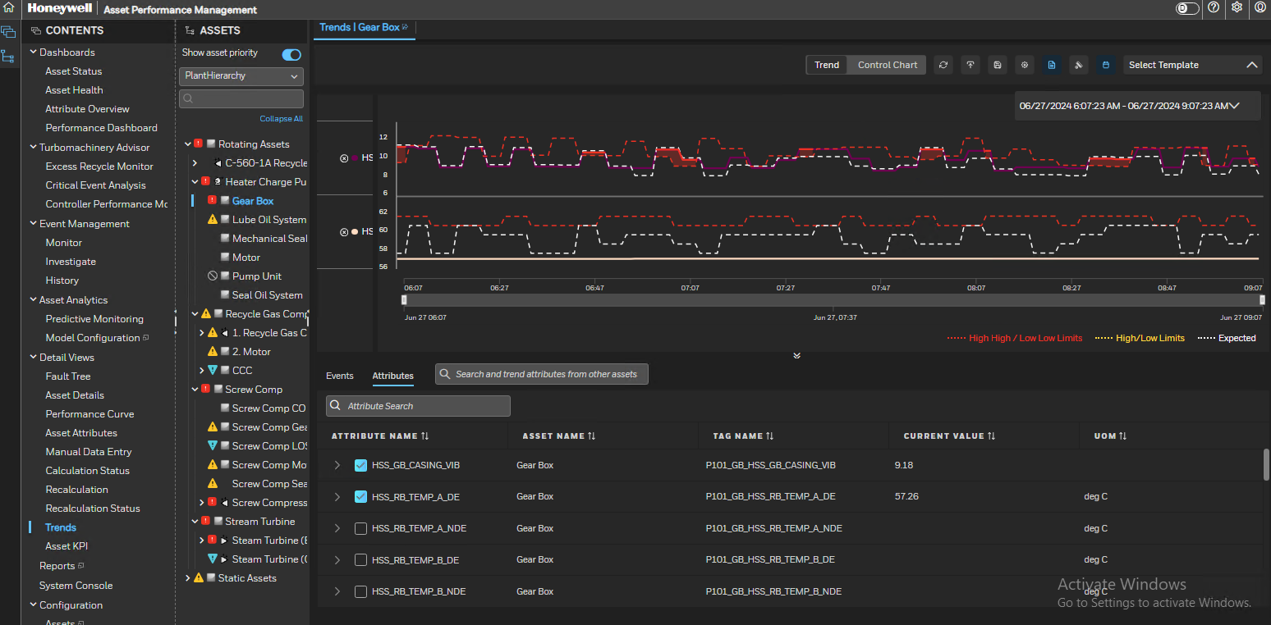
CREATE DEFAULT ASSET TRENDS
To create the Asset trend for a selected asset based on its attributes, you can Click on Asset Trend on the Contents View.
The Asset trend window for the selected Asset will get displayed. Any preconfigured trend shall be available for viewing.
To create a new trend, click on the downward arrow.
Then click on the radio button of the attributes from the down side pane into the trend window.
By default, the trend will be a time series trend with time in the X-axis.
The X-Y trend can be plotted by having attributes dragged and dropped to both X and Y axis.
Multiple attributes can be plotted in the Y-axis for a time series trend.
The time scale for the trend can be changed using the time picker in the top right corner.
Save Trend by clicking on

Slide 25
EXISTING Model Configuration Block Diagram
II
Model Configuration
1
Asset Configuration
2
Static Attribute Value Update
3
Dynamic Attribute Tag Mapping
Existing models
1
Asset limit update/Property update
4
Asset Model Mapping and model scheduling
5

Slide 26
Existing Model Configuration Block Diagram
1
Asset Configuration
2
Static Attribute Value Update
3
Dynamic Attribute Tag Mapping
1. Right Click on Existing Asset
1. Click the “Attribute Datasource Mapping” tab
1. Click the Attribute Value Configuration tab
2. Click on Add
2. Select the attribute for which OPCDA tag is to be mapped
2. Click the attribute you want to edit.
3. Enter the following details:
Name
Display Name
Description
Criticality
Class
Type
Confirm status
3. Click on Use Direct Mapping
3. Click the Edit icon to enable the Value field
4. Select Read DataSource as PHDDA/OPCDA/EPKSDA
4. Edit the value
5. Click on Save
5. Under Historical, Select DataSource as PHDHDA
4. Click on Save
6. Enter the Tagname in front of PHDHDA datasource
7. Click on Save

Slide 27
Existing Model Configuration Block Diagram
4
Asset limit update/Property update
5
Asset Model Mapping and model scheduling
1. Select an Asset from the “PlantHierarchy”.
1. Navigate to “Calculation Configuration” menu
2. Select Asset Attribute under Detail Views.
2. Select all the calculation models
3. Double click on Attribute
3. Click on Save
4. Enter High and Low Limit
4. Click on schedule calculation icon.
5. Click on Save
5. Select execute calculation every 1 minute
6. Click on Save

Slide 28
Module1
MODEL CONFIGURATION USING EXISTING MODELS- BCT (BULKCONFIGURATION TOOL) APPROACH

Slide 29
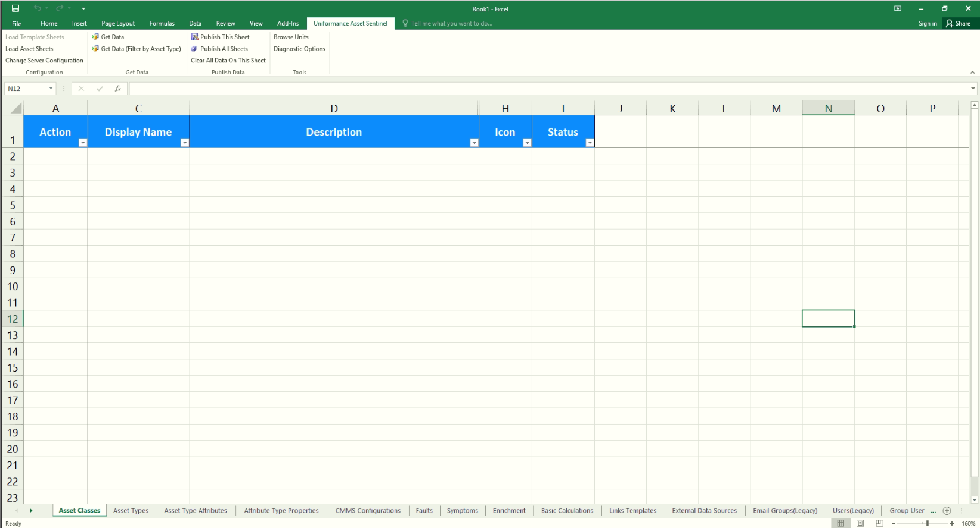
UAS Excel Add-in(BCT)
UAS Excel Add-in Toolbar Listed below
Configuration
Load Template Sheets
Load Asset Sheets
Change Server Configuration
Get Data
Get Data
Get Data(Filter By Asset)
Get Data(Filter By Asset Type)
Publish Data
Publish This Sheet
Publish All Sheet
Clear All Data On This Sheet
Tools
Browse Units
Diagnostic Options

Slide 30
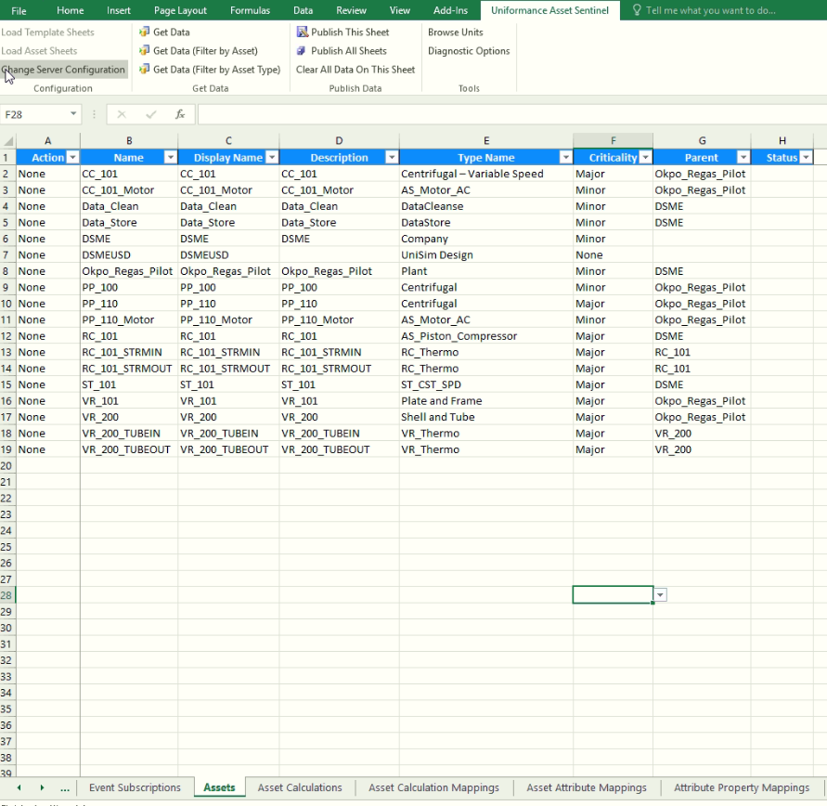
ASSET CONFIGURATION
Open a new Excel sheet.
Select Uniformance Asset Sentinel Tab.
Load Asset Sheets.
Select “Assets” Sheet
Define Asset Name, Display Name, Description, asset type Name, Criticality and Parent asset details.
In Action Column Drop down, select Create
Publish this sheet.

Slide 31
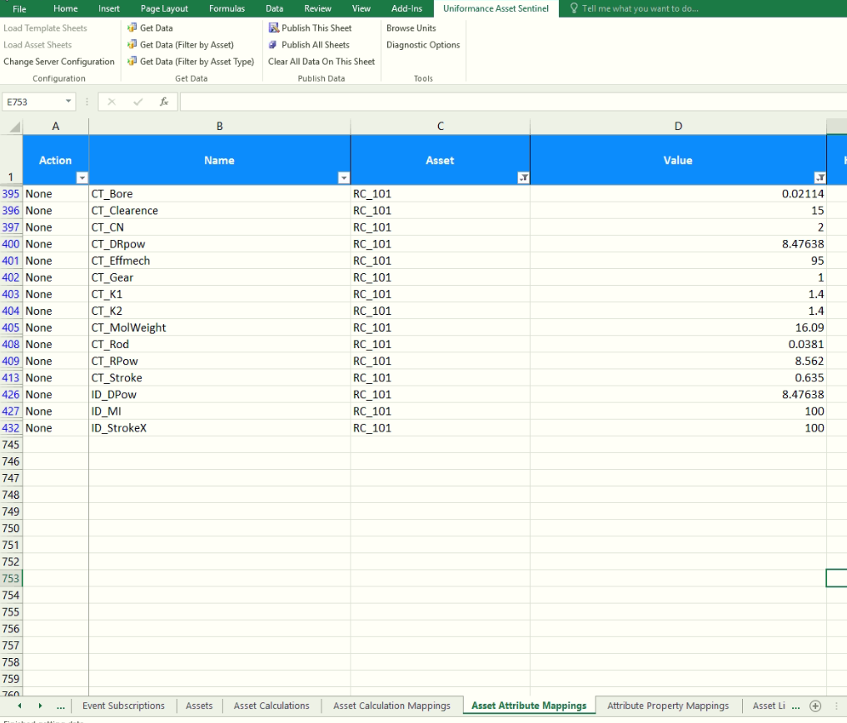
STATIC ATTRIBUTE VALUE UPDATE
Open a new Excel sheet.
Select Uniformance Asset Sentinel Tab.
Load Asset Sheets.
Select Asset Attribute Mappings Sheet.
Click on “Get Data (Filter by Asset)” to get the attributes for an asset.
Enter the asset name in the pop-up window and click on ok.
All the attributes of the asset shall be loaded in the window.
In Value column enter design value for each static attribute.
In Action Column Drop down, select Update
Publish this sheet.

Slide 32
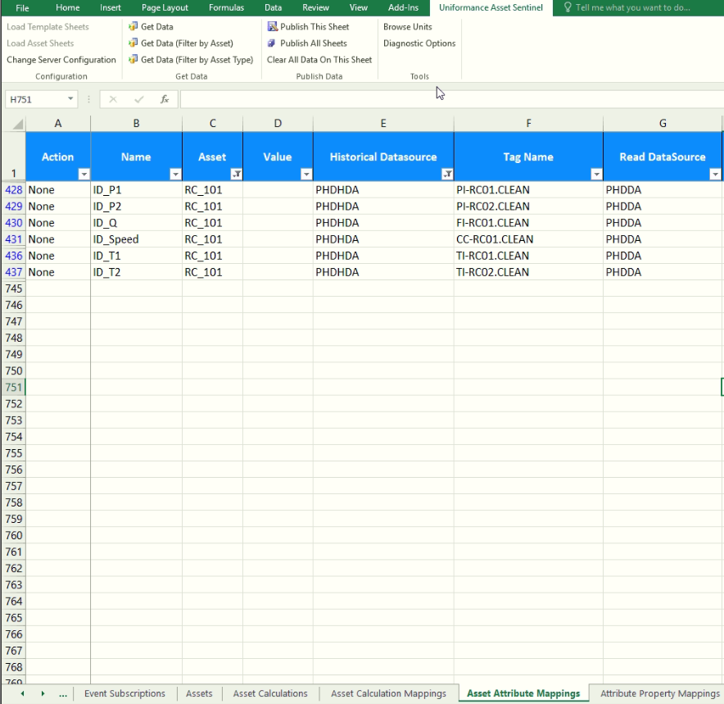
DYNAMIC ATTRIBUTE TAG MAPPING
Open a new Excel sheet.
Select Uniformance Asset Sentinel Tab.
Load Asset Sheets.
Select Asset Attribute Mappings Sheet.
Click on “Get Data (Filter by Asset)” to get the attributes for an asset.
Enter the asset name in the pop-up window and click on ok.
All the attributes of the asset shall be loaded in the window.
For dynamic tags, select the data source and tag name for read/write depending on the attribute. For the different combinations, please refer “Dynamic Attribute Tag Mapping” slide.
In Action Column Drop down, select Update
Publish this sheet.

Slide 33
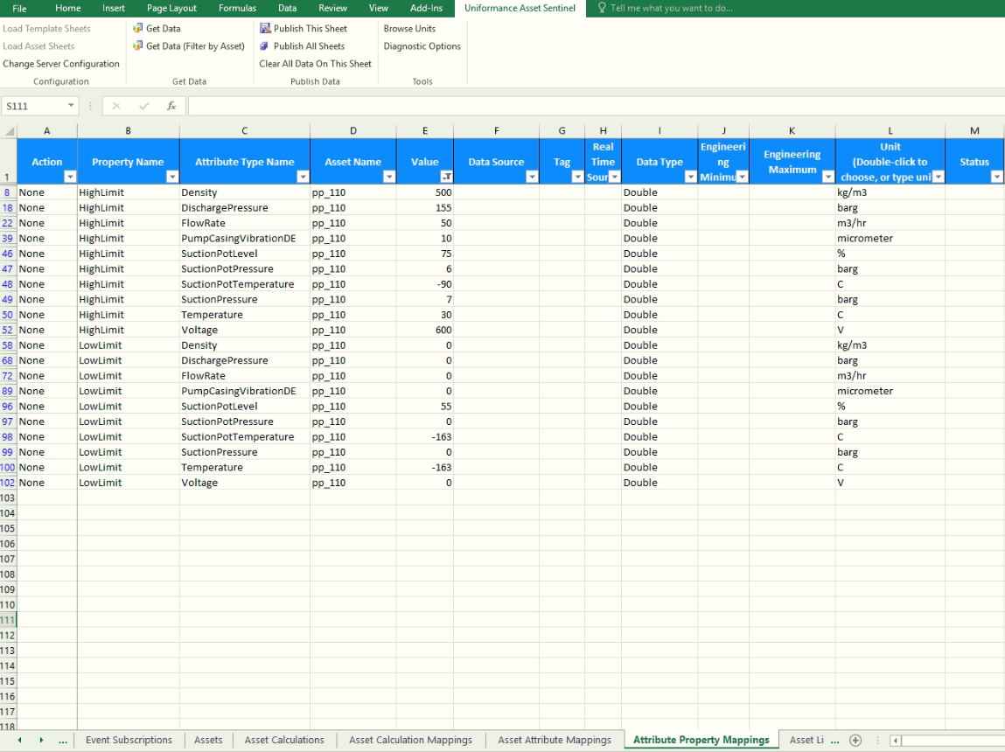
ASSET LIMIT UPDATE/PROPERTY UPDATE
Open a new Excel sheet.
Select Uniformance Asset Sentinel Tab.
Load Asset Sheets.
Select Attribute Property Mappings Sheet.
Click on “Get Data (Filter by Asset)” to get the attributes for an asset.
Enter the asset name in the pop-up window and click on ok.
All the attributes properties of the asset shall be loaded in the window.
Enter High and Low Limit value with respect to each attribute.
In Action Column Drop down, select Update
Publish this sheet.

Slide 34
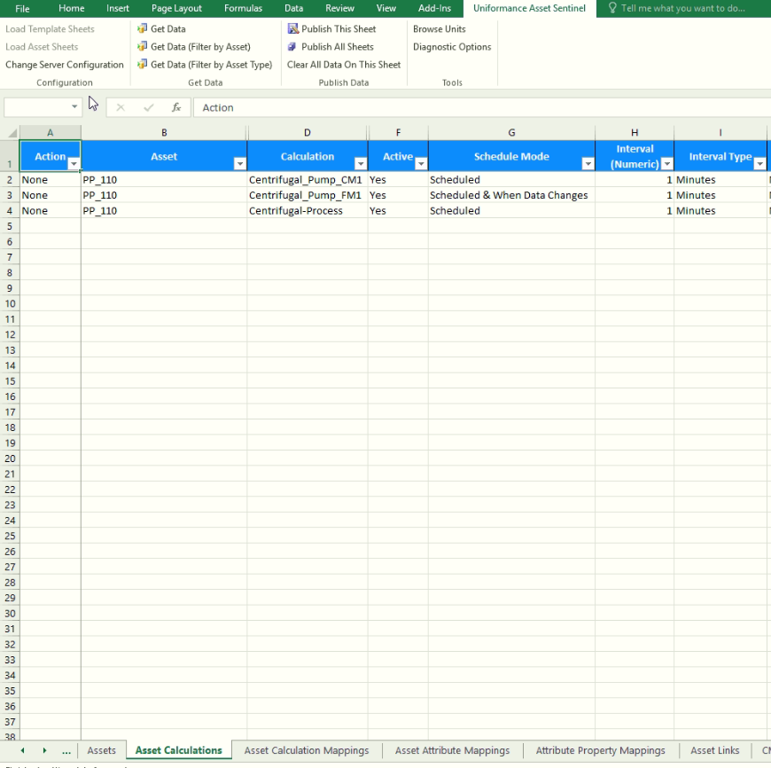
ASSET MODEL MAPPING AND SCHEDULING
Open a new Excel sheet.
Select Uniformance Asset Sentinel Tab.
Load Asset Sheets.
Select Asset Calculations Sheet.
Click on “Get Data (Filter by Asset)” to get the attributes for an asset.
Enter the asset name in the pop-up window and click on ok.
All the models associated with an asset will be populated.
Select “YES” in Active column for enabling the calculation for an asset.
Select the Schedule mode from the Schedule Mode column. A model can be scheduled or run on data change or can be run on both scheduled and data change.
In Interval column specify the time for scheduling the model in minutes.
Select “Interval Type” as minutes.
Provide anchor date/month/year if the model needs to be anchored based on a particular date.
In Action Column Drop down, select Create
Publish this sheet.

Slide 35
Module2
BUILDING NEW MODELS-UI APPROACH

Slide 36
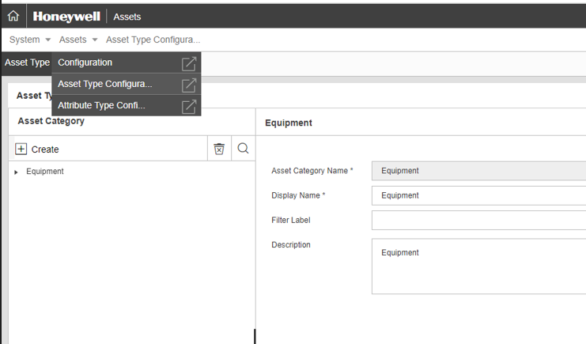
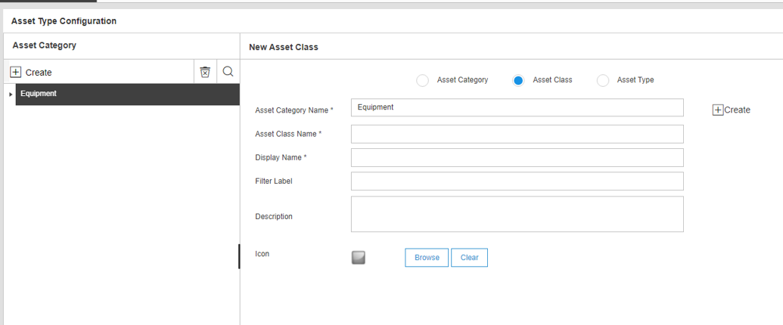
ASSET CLASS CONFIGURATION
Navigate to Asset Configuration page. Select Asset Type configuration.
A new asset class can be added by right clicking on +create and selecting “Add AssetClass” option.
The selected asset class icon is displayed in Asset Hierarchy for the asset belonging to respective class.
The icons need to be placed in a specific location (<Installed drive>:\Program Files(x86)\Honeywell\MES\Core\WWWMESCore\AMInformationFolders in the UAS server and should be in “.png” format.
To select an existing icon, click “Browse” and select the image from the specific location.

Slide 37
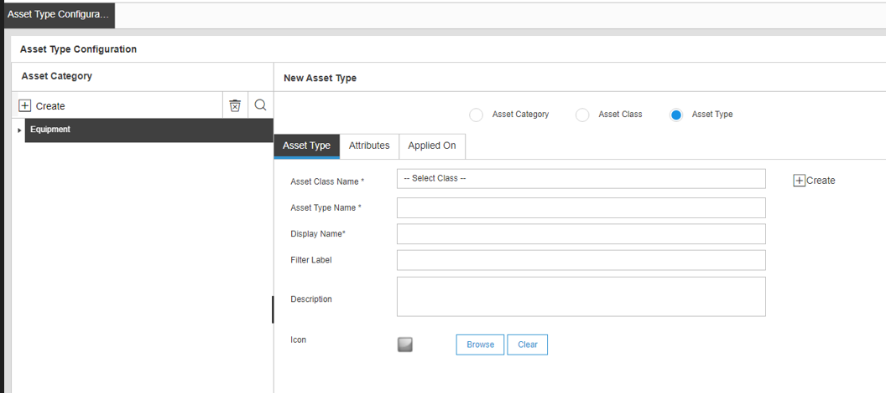
ASSET TYPE CONFIGURATION
Navigate to Asset Configuration page and select asset type configuration from System > Assets dropdown.
A new asset class can be added by right clicking on create and selecting “Add Asset type” option.
Provide * highlighted information and save to create the asset type under asset class.

Slide 38
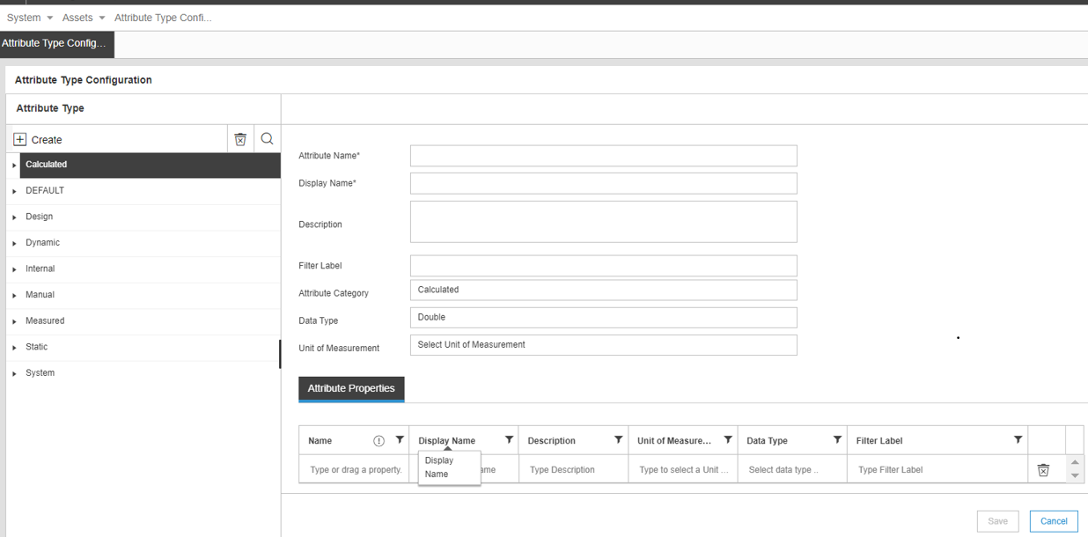
ATTRIBUTE TYPE CONFIGURATION
Asset type contains asset attributes e.g. Running Status, Availability, Performance, Quality, etc.
Click Create to add new attribute or click to edit existing attribute.
Attribute Name is used to define calculation expression.
Attribute can be of type ‘Double’, ‘Integer’, ‘String’, etc.
Attribute category can be ‘Static’, ‘Dynamic’, etc.
Units of measurement can be defined for the attribute e.g. m3/hr, %, etc. To use Intuition unit conversion, please use BCT for updating UoM of attributes.
Attribute filter can be used to categorize the type of attribute. e.g. Design, Availability, etc.
Attributes can be defined using attribute configuration page or excel plug-in
Ensure
The first character of the attribute name is alphabet.
The attribute name is case sensitive.
The attribute name does not begin with C_ (this prevents the attribute from being used in fault, symptom, or calculation expressions).
The length of an attribute name must not exceed 50 characters.
Provide the same attribute name, which is case sensitive while defining expressions in calculation and fault models

Slide 39
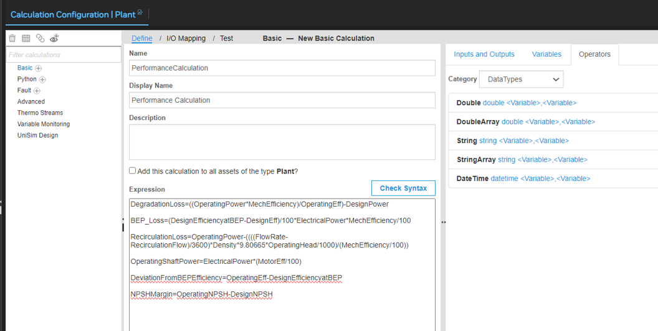
CALCULATION MODEL CONFIGURATION
Navigate to calculation Configuration page from contents tree.
Click on Basic“+” symbol to add a new calculation model.
New calculation window appears for adding calculation.
Provide name, display name, description and expression.
Build calculation expression using various operators and functions and click “check syntax” to validate calculation syntax.
Click Save to save the calculation.
Repeat the steps 2-5 for adding more calculations.
Use Add this calculation to templatize for that respective asset type.

Slide 40
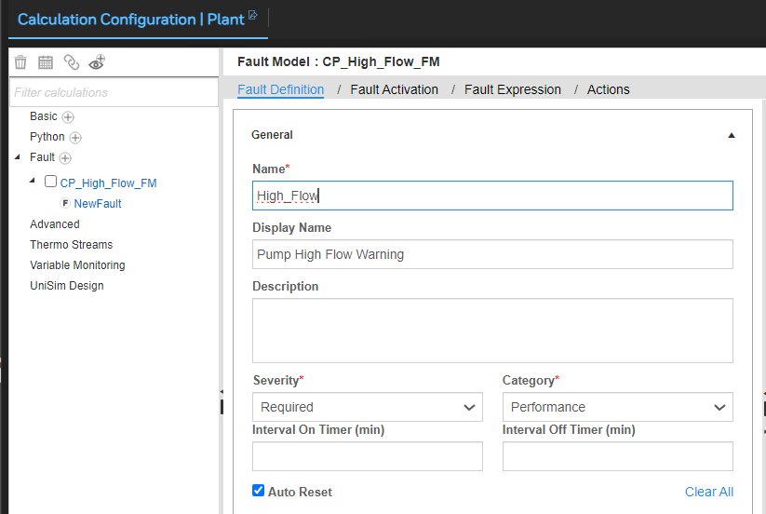
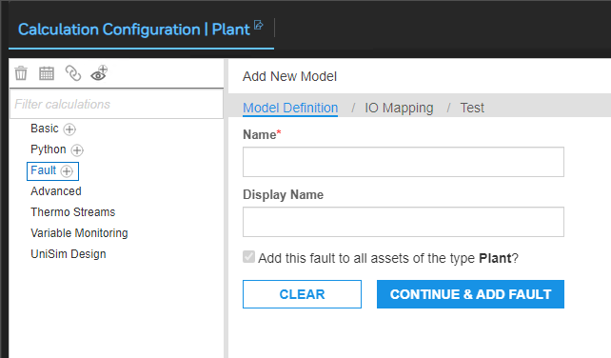
FAULT AND SYMPTOM MODEL CONFIGURATION
Navigate to calculation Configuration page from contents tree.
Click on Fault“+” symbol to add a new Fault model.
Right click on fault symptom model and select “Add Fault”
Provide name, display name, description, severity, category and on/off interval for fault in general tab.
Provide fault expression using various operators and functions and click “check syntax” to validate fault syntax.
Click Save to save the fault.
To add a new Symptom, right click on fault and select “Add Symptom” and follow steps 3 to 5.

Slide 41
NEW Model Configuration Block Diagram
II
Model Configuration
1
Asset class configuration
2
Asset type configuration
3
Attribute type configuration
New Model
2
4
Calculation model configuration
5
Fault-Symptom model configuration
For Asset Configuration, refer Steps given in Existing model
6

Slide 42
NEW Model Configuration Block Diagram
1
Asset class configuration
2
Asset type configuration
3
Attribute type configuration
1. Navigate to Template Configuration page
1. Navigate to Template Configuration page
1. Click (+) to add new attribute
2. Right click on any existing Asset Class.
2. Click on to edit existing attribute
2. Right clicking on any existing Asset Class
3. Select “Add AssetType”
3. Enter the following details:
Name
Display Name
Description
DataType
Default Value
Category
TrendType
Units
Filter Category
3. Select “Add AssetClass”
4. Enter the following details:
Asset Type Name
Display Name
Type Description
Asset Image
4. Enter the following details:
Asset Class
Display Name
Class Description
Icon
5. Click on Save
5. Click on Save
7. Click on Save

Slide 43
NEW Model Configuration Block Diagram
4
Calculation model configuration
5
Fault-Symptom model configuration
1. Click on “+” symbol to add a new calculation model.
1. Click on “+” symbol to add a new fault-symptom mode
2. Right click on fault symptom model
2. Right click on calculation model and select “Add Calculation”.
3. Select “Add Fault”
3. Enter the following details:
Name
Name
Display name
Description for calculation
Click next
4. Enter the following details:
Name
Display Name
Description
Severity
Category
On/off interval
Fault expression
4. Build calculation expression using various operators and functions and click “Validate” to validate calculation syntax.
5. Click Validate
5. Click on Save
6. Click on Save
6. Repeat the steps 2-5 for adding more calculations.
7. To add a new Symptom, right click on fault and select “Add Symptom” and follow steps 3 to 5.

Slide 44
Module2
BUILDING NEW MODELS-BCT APPROACH

Slide 45
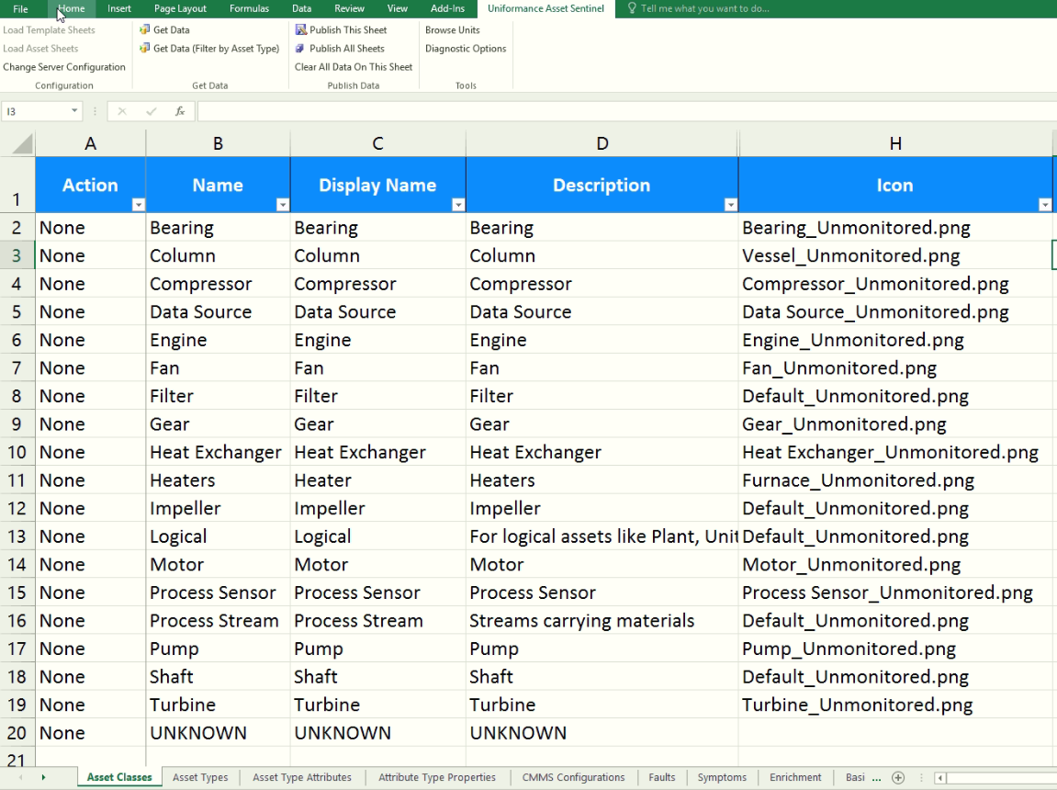
ASSET CLASS CONFIGURATION
Open a new Excel sheet.
Select Uniformance Asset Sentinel Tab.
Load Template Sheets.
Select Asset Classes Sheet
Define Class Name, Display Name and Description along with icon image name as per file name in the specific location.
In Action Column Drop down, select Create
Publish this sheet.

Slide 46
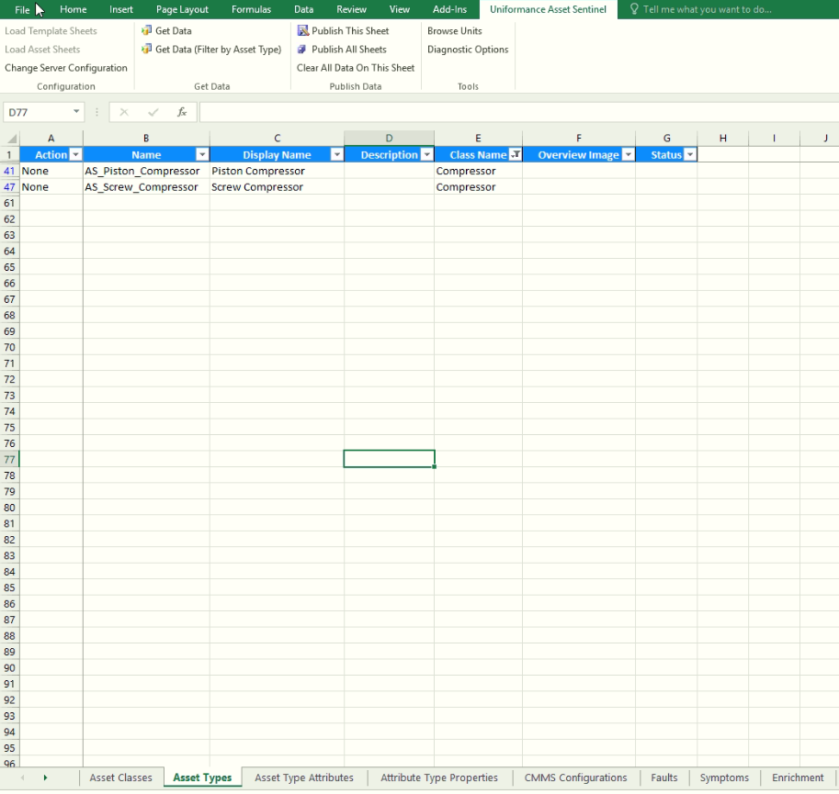
ASSET TYPE CONFIGURATION
Open a new Excel sheet.
Select Uniformance Asset Sentinel Tab.
Load Template Sheets.
Select Asset Types Sheet.
Define Asset Type Name, Display Name and Class Name.
In Action Column Drop down, select Create
Publish this sheet.

Slide 47
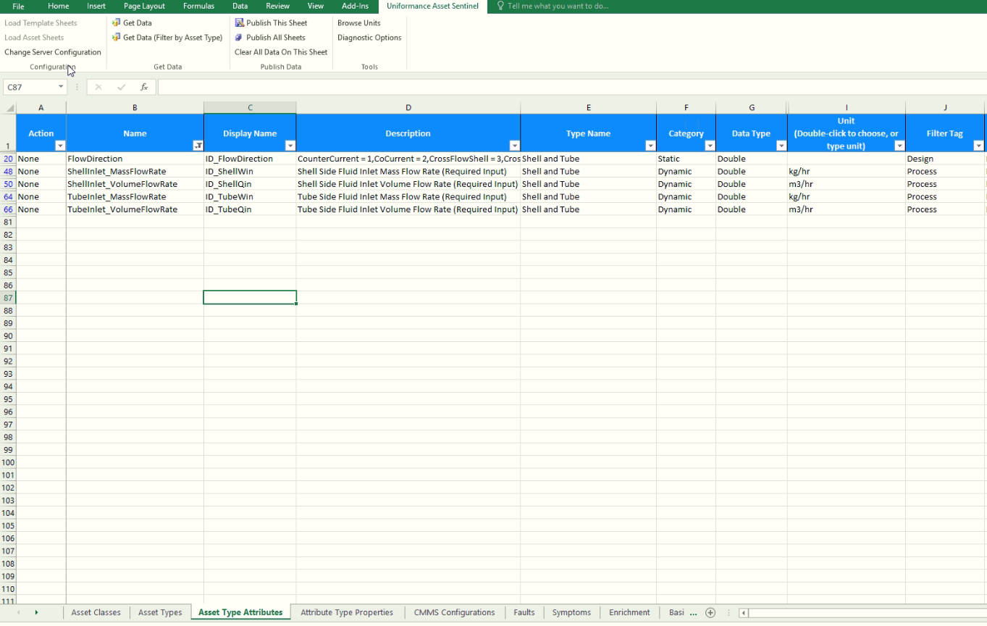
ATTRIBUTE TYPE CONFIGURATION
Open a new Excel sheet.
Select Uniformance Asset Sentinel Tab.
Load Template Sheets.
Select Asset Types Attribute Sheet.
Define Attribute Name, Display Name, Asset Type Name , Category, Data type, UoM and Filter Tag.
UoM can be selected from dropdown from a list of unit and unit categories.
Keep “Preserve to Default History Data Source” and “Preserve to Default State Data Source” as “No”.
In Action Column Drop down, select Create
Publish this sheet.

Slide 48
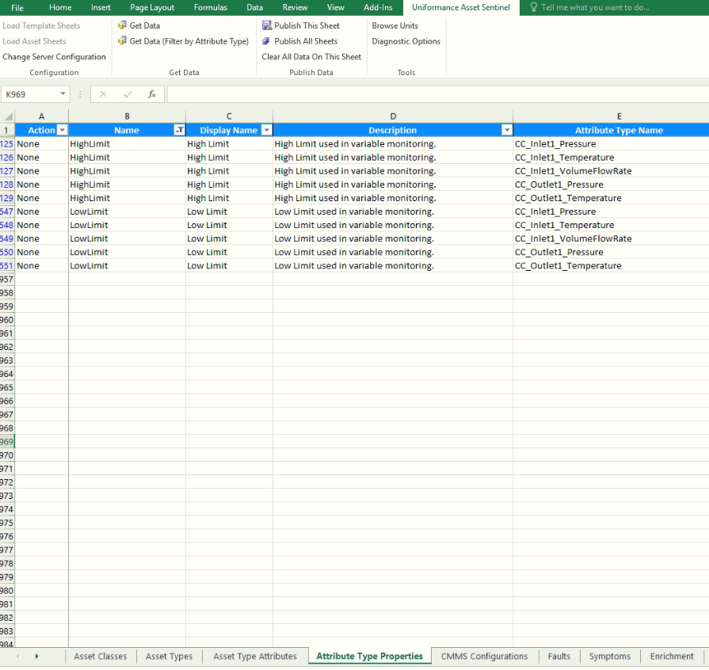
ATTRIBUTE PROPERTIES CONFIGURATION
Open a new Excel sheet.
Select Uniformance Asset Sentinel Tab.
Load Template Sheets.
Select Attribute Types Properties Sheet.
Define Attribute Property Name, Display Name, Attribute Type Name.
In Action Column Drop down, select Create
Publish this sheet.

Slide 49
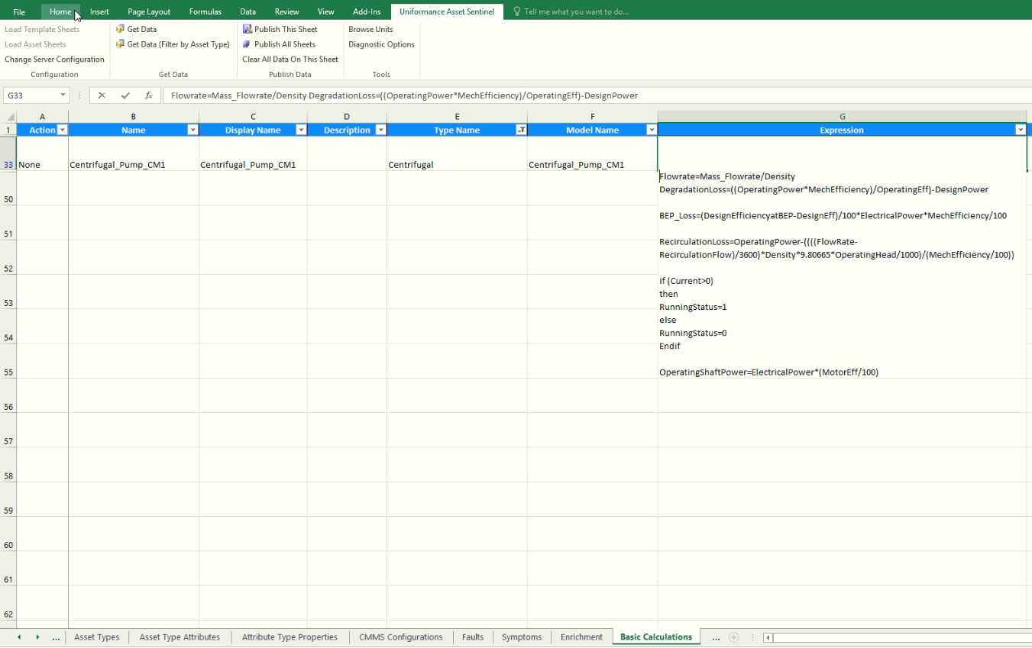
CALCULATION MODEL CONFIGURATION
Open a new Excel sheet.
Select Uniformance Asset Sentinel Tab.
Load Template Sheets.
Select Basic Calculations Sheet.
Define Calculation Name, Display Name, Description, Asset Type name, model Name and Calculation Expression.
In Action Column Drop down, select Validate.
Publish this sheet.
If the calculations are successfully validated, in Action Column Drop down, select Create.
Publish this sheet.

Slide 50
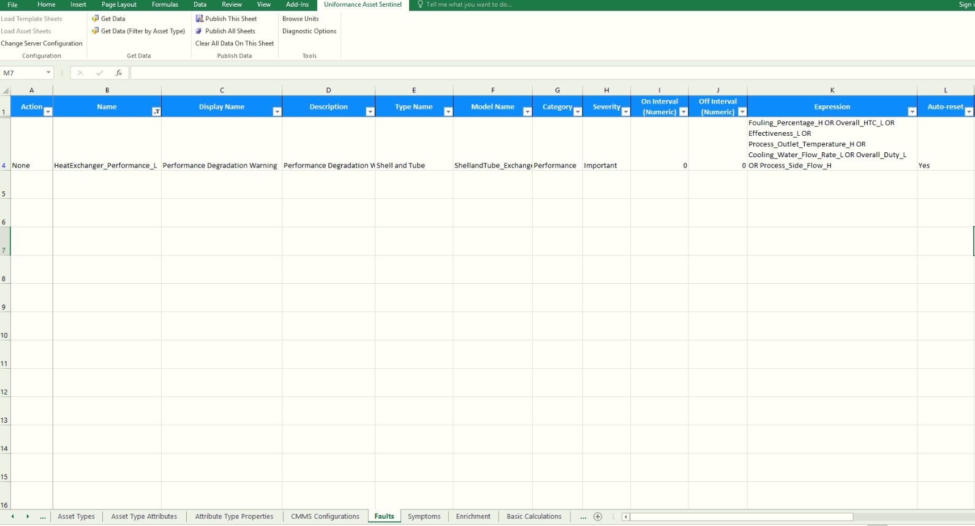
FAULT AND SYMPTOM MODEL CONFIGURATION
Open a new Excel sheet.
Select Uniformance Asset Sentinel Tab.
Load Template Sheets.
Select Faults Sheet.
Define Fault Name, Display Name, Description, Asset Type Name, Model Name, Category, Severity, On/Off Intervals, Fault Expression, Auto Reset ,Repair action ,Context ,OPC notification , Mail Notification and CMMS Notification
In Action Column Drop down, select Validate.
Publish this sheet.
If the faults are successfully validated, in Action Column Drop down, select Create.
Publish this sheet.

Slide 51
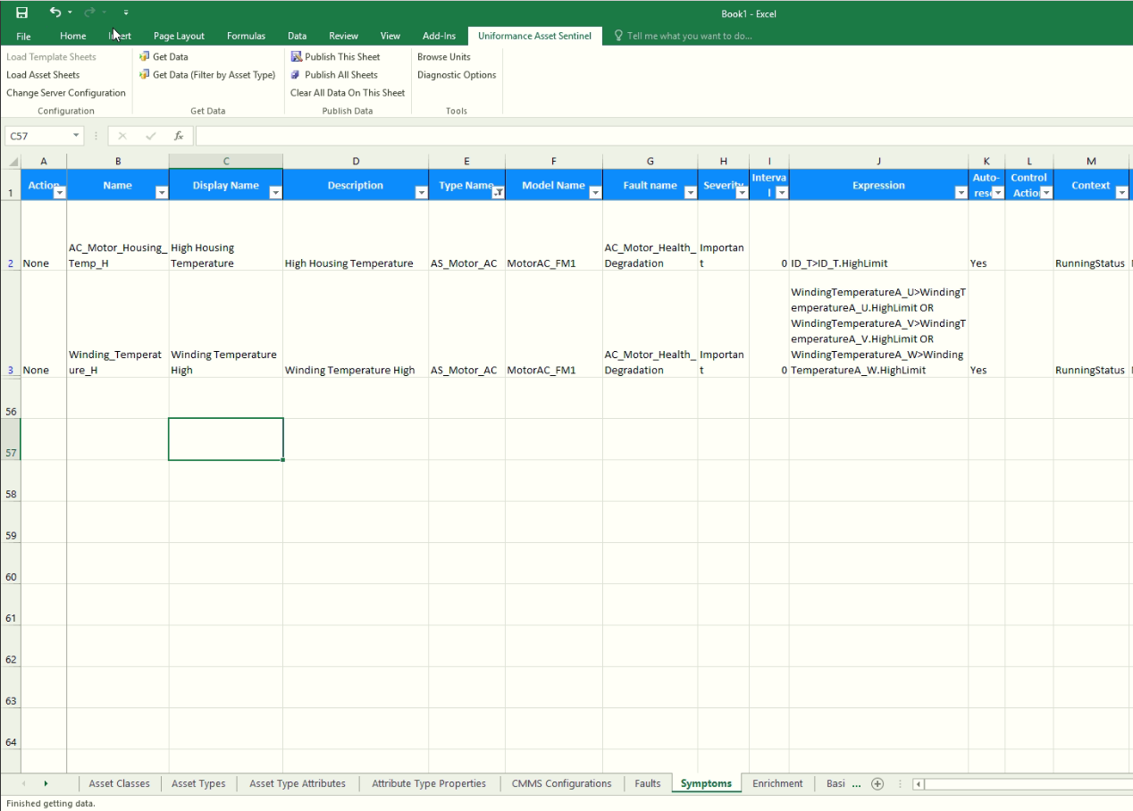
FAULT AND SYMPTOM MODEL CONFIGURATION
(Cont..)
Open a new Excel sheet.
Select Uniformance Asset Sentinel Tab.
Load Template Sheets.
Select Symptoms Sheet.
Define Symptom Name, Display Name, Description, Asset Type Name, Model Name, Fault Name, Severity,Intervals, Fault Expression, Auto Reset , Control action ,Context ,OPC notification , Mail Notification and CMMS Notification.
In Action Column Drop down, select Validate.
Publish this sheet.
If the Symptoms are successfully validated, in Action Column Drop down, select Create.
Publish this sheet.

Slide 52
Module2
GRAPHICS CHANGES-HMI WEB BUILDER

Slide 53
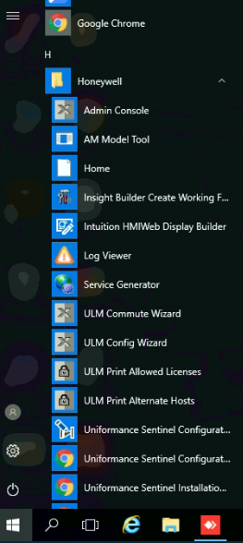
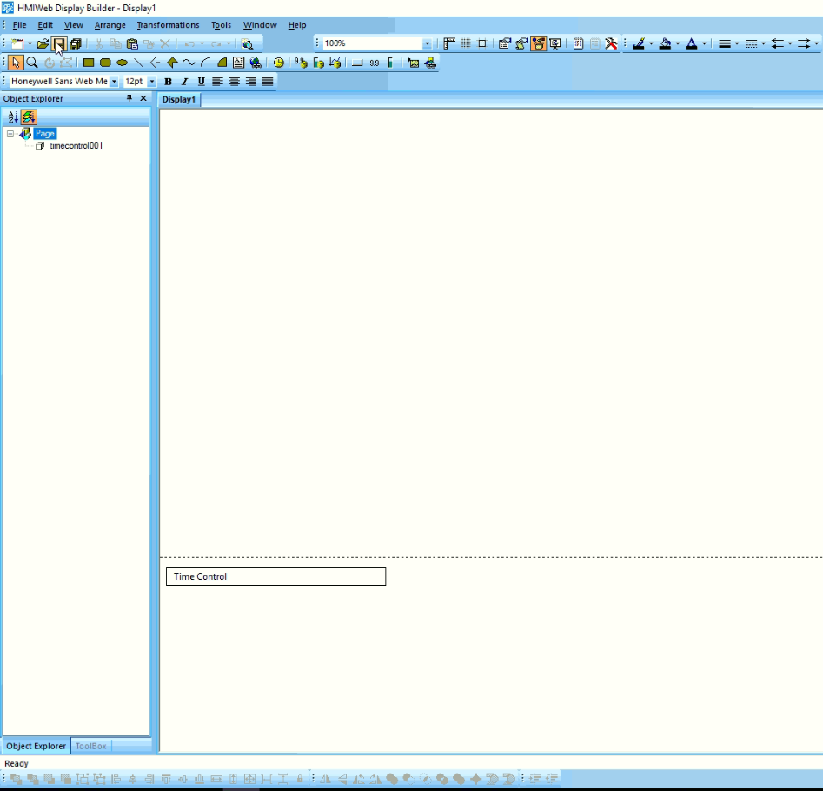
GRAPHICS TOOLBARS
In UAS server, go to Start Menu.
Click on Intuition HMIWeb Display Builder.
HMI workspace will open.
This tool bar will help to make inlet and out line lines .
Click on insert shape from file icon
Click on insert picture from file icon
Click on save icon

Slide 54
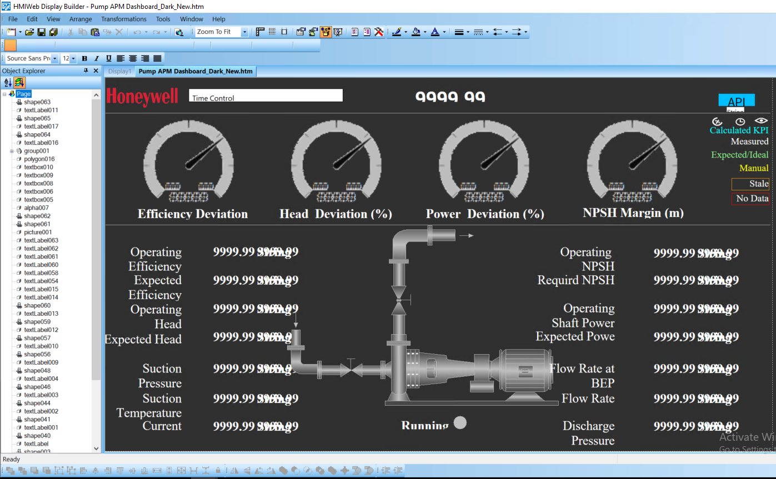
ADDING NEW TAGS/MODIFYING EXISTING TAG MAPPINGS
In UAS server, go to Start Menu.
Click on Intuition HMIWeb Display Builder.
HMI workspace will open.
Open the Existing graphics from the Graphic Location.
Select and Click on the Attribute.
Click on Custom properties.
Change The Tag Name with respect to the process.
Save Graphics.

Slide 55
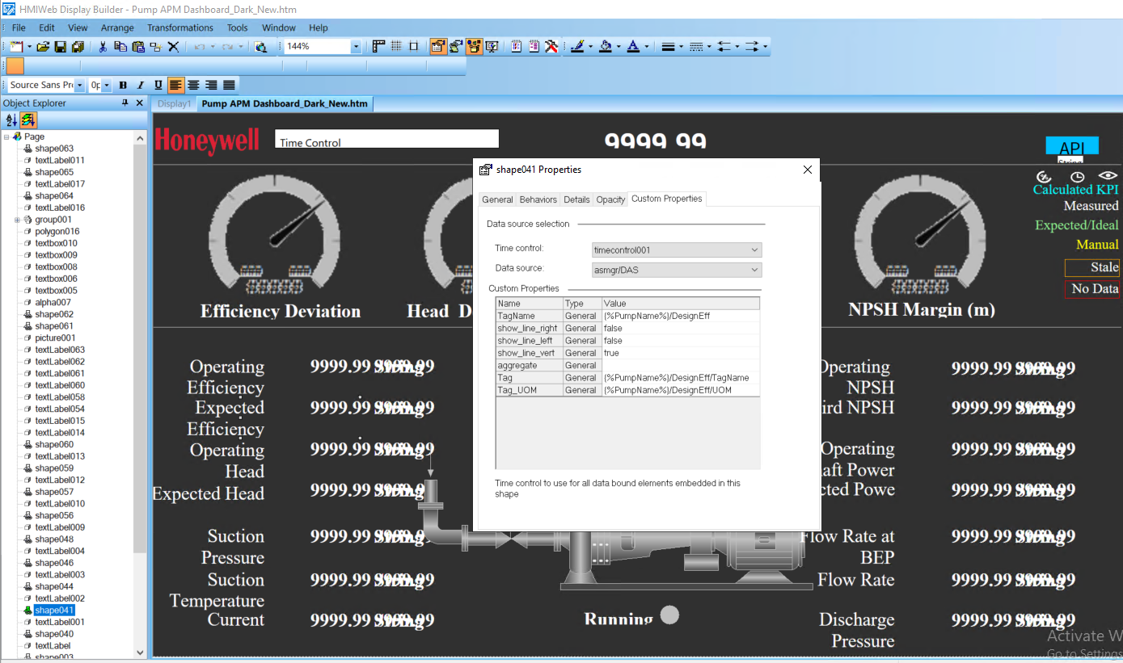
UPDATING SHAPES
Open a graphics from the defined location
Click on shape ,the shape property will open
Click on Details ,user can see the shape name.
Click on insert shape from file icon
Click on insert picture from file icon
Click on save icon

Slide 56
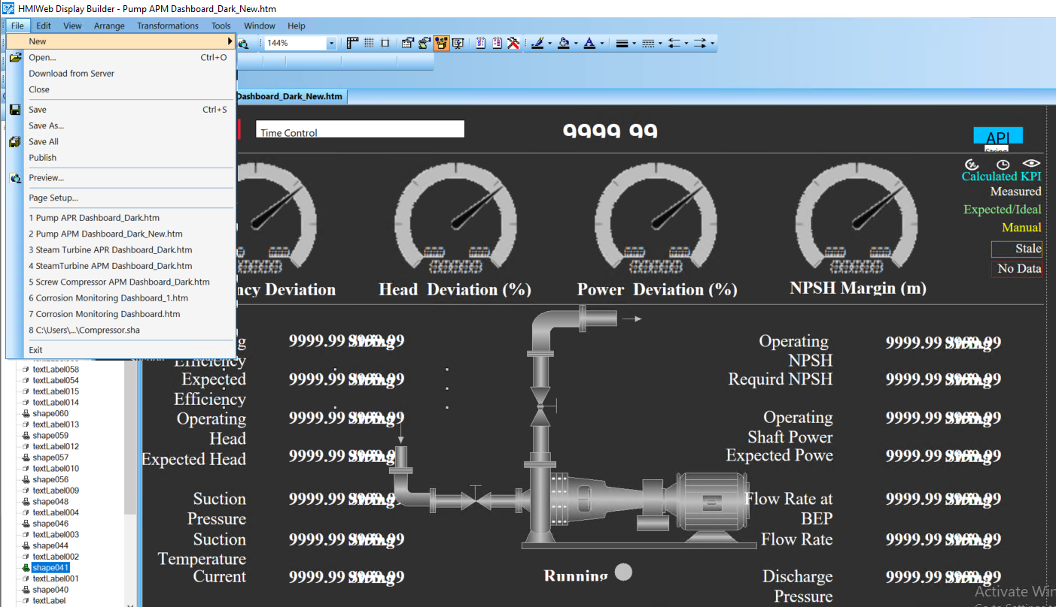
SAVING AND PUBLISHING GRAPHICS
Once Graphic Modifications are done, go to File Tab and then save the Graphics and then Publish the graphics.

Slide 57
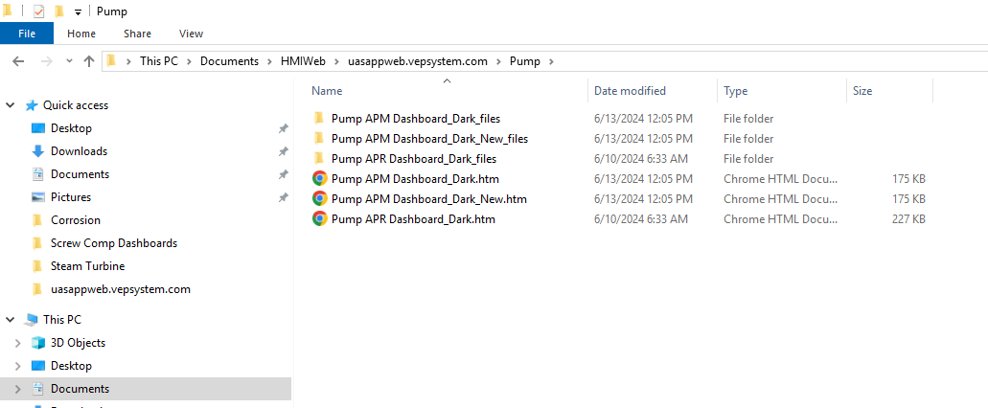
GRAPHICS LOCATION

Slide 58
Graphics modification Block Diagram
III
Graphics changes-HMI Web builder
1
Adding new tags
2
Updating shapes
Saving and publishing graphics
3
4
Graphics location

Slide 59
Graphics changes in hmi Block Diagram
1
Adding new tags
2
Updating shapes
Saving and publishing graphics
3
1. Go to Start Menu
1. Open a graphics from the defined location
1. Go to File Tab
2. Click on Intuition HMIWeb Display Builder
2. Click on shape ,the shape property will open
2. Save the Graphics
3. Open the Existing graphics from the Graphic Location
3. Publish the graphics
3. Click on Details ,user can see the shape name.
4. Select and Click on the Attribute
4
Graphics location
4.Click on insert shape from file icon
1. Save the file on this location on the local server:
5. Click on Custom properties
5.Click on insert picture from file icon
6. Change The Tag Name with respect to the process
6. Click on Save
7. Click on Save
8. Click on Publish

Slide 60
Module2
ASSET HIERARCHY UPDATES

Slide 61
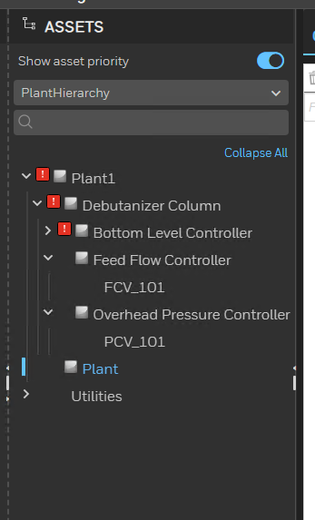
ASSET HIERARCHY
Asset Hierarchy
The asset hierarchy is a hierarchical display of the assets in plant hierarchy
Logical assets can be used in hierarchy for grouping assets belonging to same area or facility under one parent

Slide 62
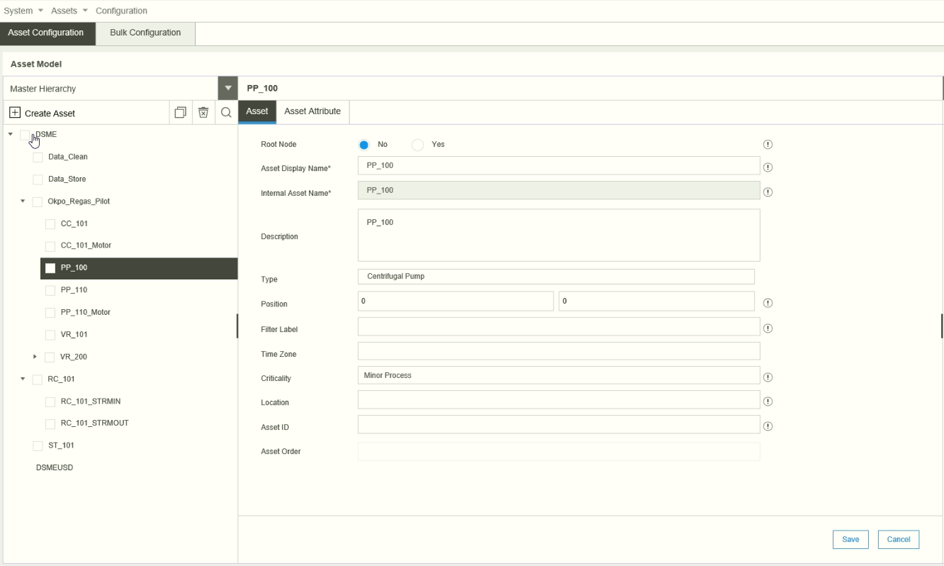
ASSET HIERARCHY UPDATES
Navigate to Asset Configuration from home page by clicking on “Assets”.
User can create and rearrange the Asset from this page.
The parent of an asset can be changed by moving the asset under another required parent asset.
Alternately, the parent asset can also be changed using the “Assets” sheet of BCT.

Slide 63
Module2
THERMO STREAM MODELS

Slide 64
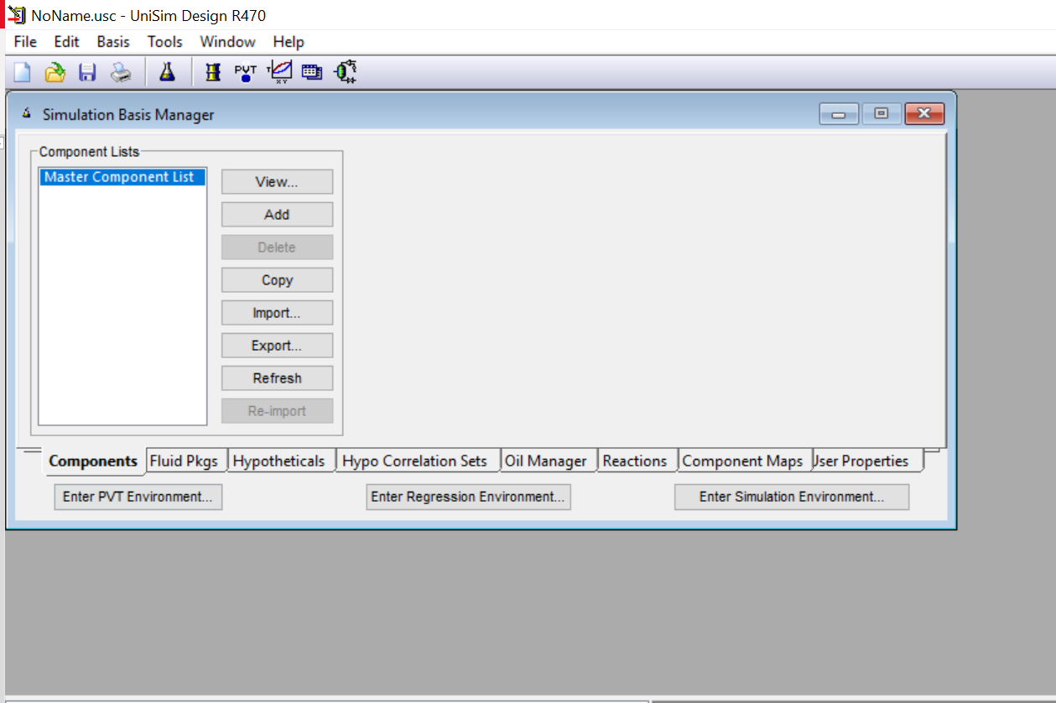
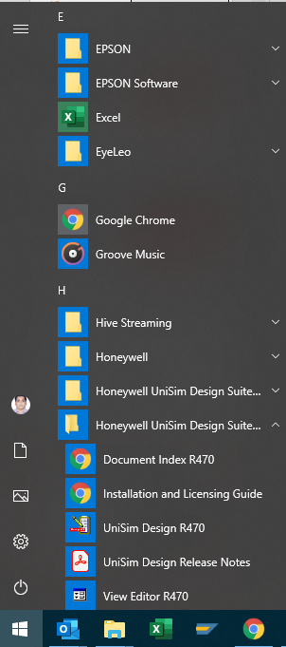
Thermo streams export from UniSim
In UAS server, go to Start Menu
On clicking on the UniSim Design Icon, a new Simulation Basis Manager page will open.
Click On Add tab and add required components for the process stream.

Slide 65
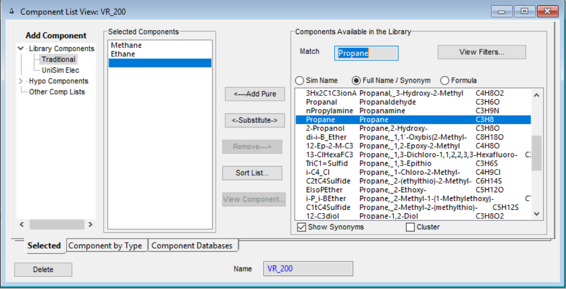
Thermo streams export from UniSim
Select required component from components library.
Click on Add Pure tab
Selected components will display
Name the components Group
Close the window.

Slide 66
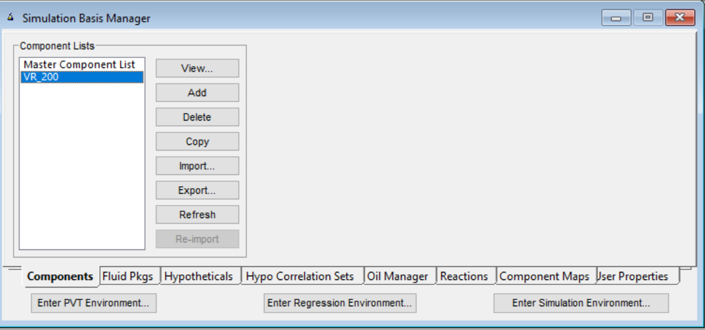
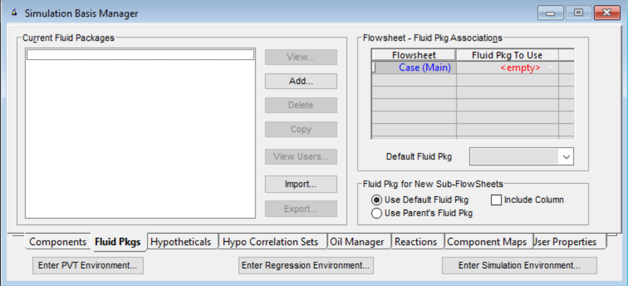
Thermo streams export from UniSim
The components group is created and shown in “Simulation Basis Manager” page under component Lists Tab.
Clicking on Fluid Pkgs tab will open Current Fluid Packages Tab
Click on Add Tab.

Slide 67
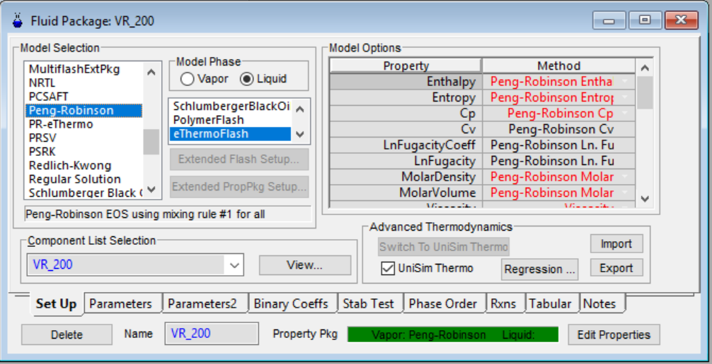
Thermo streams export from UniSim
Click On Add Tab will open Model Selection page
Select UniSim Thermo
Select Required model from the Model Selection tab.
Select “eThermoFlash” for both Vapour and Liquid in Model Phase Tab.
Click on Export and save the Thermo Model in “.ctf” format.

Slide 68
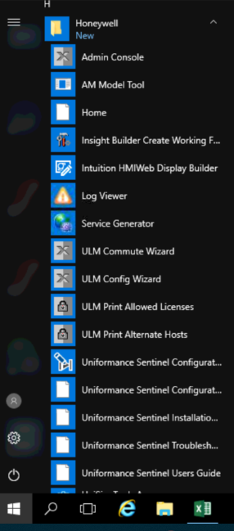
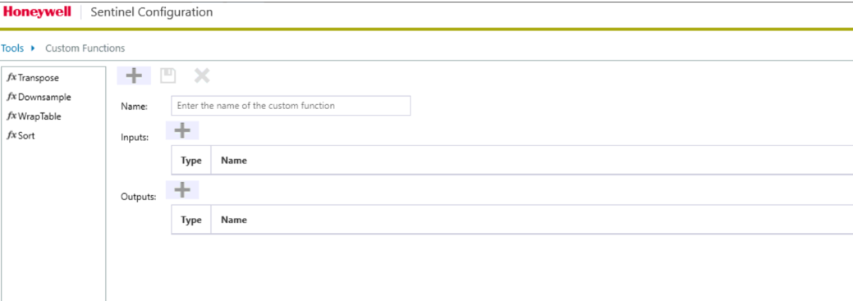
Thermo streams Import to UAS
In UAS server, Click on Start Menu
Under Honeywell, click on Uniformance Sentinel Configuration Tab
Sentinel Configuration Page will open

Slide 69

Thermo streams Import to UAS
Click on Tools.
In dropdown select Import Thermo Configuration.

Slide 70


Thermo streams Import to UAS
Click on and Create New Asset Type. Keep asset class as “Process Stream”.
Under Create New Asset Type Tab add details like Asset Class, Asset Type Name, Display Name and Type Description.
Click on and Create New Calculation
Under Create New Calculation Tab add details like Calculation Name. This corresponds to the calculation model in UAS.

Slide 71

Thermo streams Import to UAS
Click on Browse tab.
Select “ctf” file from the saved location.
Click on Open Tab.

Slide 72

Thermo streams Import to UAS
Keep all the inputs as it is.
Uncheck the Output Selection.
Select the following Outputs Only as given in below table.
Click on Save Calculation Tab.
Attribute Name | Phase
Cp | Overall
CV | Overall
Density | Overall
Enthalpy | Overall
Entropy | Overall
Molecular Weight | Overall
PhaseFraction | Overall
ZFactor | Vapour

Slide 73

Thermo streams Configuration
Go to Sentinel Dashboard and Under configuration click on Assets Tab ,Asset configuration page will open
Select “Asset type configuration” from the “Assets” Dropdown
Expand Process Stream Asset Type and user can see the Imported Thermo Model.

Slide 74

Thermo streams Configuration
Go to Sentinel Dashboard and Under configuration click on Assets Tab ,Asset configuration page will open
Select configuration from the Asset Dropdown
To create a thermo stream asset, select respective parent Asset from Master Hierarchy and click on Create Asset.
Update the details in Asset Creation Tab like Asset Display Name, Internal Asset Name , Description, Type and Criticality.
Click on Save .
Stream will be added under respective Asset.

Slide 75
Module3
UNISIM MODELS

Slide 76
UNISIM MODEL CREATION
In UAS server, go to Start Menu
On clicking on the UniSim Design Icon, a new Simulation Basis Manager page will open.
Click On Add tab and add required components for the process stream

Slide 77
UNISIM MODEL CREATION (Cont..)
Select required component from components library.
Click on Add Pure tab
Selected components will display
Name the components Group
Close

Slide 78
UNISIM MODEL CREATION (Cont..)
The components group is created and shown in “Simulation Basis Manager” page under component Lists Tab
Clicking on Fluid Pkgs tab will open Current Fluid Packages Tab
Click on Add Tab

Slide 79

UNISIM MODEL CREATION (Cont..)
Click On Add Tab will open Model Selection page
Select Required model from the Model Selection tab
Name the Fluid Package
Click on close icon.

Slide 80

UNISIM MODEL CREATION (Cont..)
Clicking On Object Tab will open Object Selection page
Select Stream from the object Selection tab
Select Expander from the object Selection tab
Connect Inlet and Outlet stream to Expander model.

Slide 81


UNISIM MODEL CREATION (Cont..)
Click On Inlet Streams to update inlet conditions like Temperature, Pressure ,Flow and composition
Click On Outlet Streams to update Outlet conditions like Temperature, Pressure and composition
Click on run icon to run the model.

Slide 82


UNISIM MODEL CREATION (Cont..)
Clicking On Tools Tab will open Tools Selection page
Select Databook from Tools Selection tab
Select Variable tab
Insert Inlet ,Outlet stream required inputs and Model output by clicking Insert Tab.

Slide 83

UNISIM MODEL CREATION (Cont..)
Select Process Data Tables
Click on Add tab
Create Input
Create Output

Slide 84

UNISIM –UAS TAG MAPPING
Sentinel Tag
USD Tag
Sentinel to USD Tag Mapping

Slide 85
UNISIM ASSETS AND ERROR CODES
Execution Mode
The following are the possible values for the execution mode attribute in UniSim Interface
asset.
o CALCULATION Run In Progress = 9
o CALCULATION Run returned SUCCESS = 12
o CALCULATION Run ERROR or not converged= 11
o CALCULATION Run Timedout = 10
Error Status
The follow are the possible values for the Error Status attribute in UniSim Interface asset.
o Not Converged =13
o Success =1
o Timed out = 20

Slide 86
Module3
EMBEDDED PHD

Slide 87

PHD TAG CONFIGURATION
PHD Tag configuration will be done by using Bulk Configuration Tool.
Below Screenshot will give an idea how the configuration of calculation output values stored in Embedded PHD.
Once Tag name is given with respect to each calculation output Attributes, Change the action column state “None” to “Update”.
Click on “Publish this Sheet” tab to update the configuration and create the PHD tags.

Slide 88


PHD MONITORING
User can Check the Configured PHD Tags by Using Command Prompt
Go To Start Menu, Open Command prompt as an administrator
Type PHDMAN and click enter
Type “mon que <Tag Name>” and click enter

Slide 89
ASSET METRICS
Uniformance Asset Sentinel provides pre-configured asset metrics template for assets in the “Equipment” category.
Asset metrics included in the template calculation can be applied to assets in the Equipment category and provides additional metrics for asset status (including cumulative status hours such as total running hours), asset availability, and asset performance.
To import the Equipment Metrics Template
1. On the installation media, locate the following file:
[install media]:\StandardLibrary\Metrics Template\AMExport_XML
2. Once the import is complete, the asset metrics calculation, type, and class appears on your system. The related calculation is scheduled and enabled.
3. This is a one-time activity for a server.

Slide 90
Module3
APPLICATION MONITORING

Slide 91

SERVICE LOGS
In UAS server, Log files are available in “C:\ProgramData\Honeywell\AssetManager\LogFiles\”
AMService.log contains AMApplicationService’s log
DataServiceLog.log contains the Data Service log
HDAService.log contains OPC HDA data source log
HoneywellAssetManagerExcelAddIn.log contains UAS Excel Plugin’s log
ImportModelsLog.txt contains AMImportModel.exe’s log
AMIntegrationService.log contains the Integration Service log
FaultViewer.log contains the Fault Viewer’s log

Slide 92

MES LOG VIEWER
Intuition Log viewer is another way of debugging method if any application issue persists.

Slide 93

AM SERVICE STOP/START
Window services console can be accessed using Run → services.msc
In UAS server, following services must be running
AMApplicationServer Service
Honeywell Intuition Calculation Service
Honeywell Intuition Event Processing Service
AssetManagerIntegrationService

Slide 94


PHD COLD STOP/START
PHD Cold Stop Steps
Open Command Prompt by Administrator
Type “phdctl stop /y”
phdctl stop /y dbsecurity
​ phdctl stop /y udbserver

Slide 95

PHD COLD STOP/START(Cont..)
PHD Cold Start Steps
Open Command Prompt by Administrator
Type “phdctl start cold”

Slide 96
SERVER RESTART PROCEDURE
STOP the PHD services first before restart of sentinel server.
PHD Cold Start /Stop Steps
Open Command Prompt by Administrator
Type “phdctl stop /y”
phdctl stop /y dbsecurity
​ phdctl stop /y udbserver
3. Restart the server

Slide 97
SERVER RESTART PROCEDURE (Cont..)
Once Server is restarted, the PHD services will be up automatically.
However, if not started, start PHD manually using below command.
PHD Cold Start Steps
Open Command Prompt by Administrator
Type “phdctl start cold”

Slide 98
Applying changes to DB
1
Go to Datasources
2
Click on Apply Changes
3
Wait for the changes to be applied
Stop AMApplicationServer Service
4
Start AMApplicationServer Service after 5 mins
5

Slide 99
Module3
SECURITY CONFIGURATION

Slide 100


Security Role Configuration
Navigate to UAS application home page.
Select System Configuration under System box. Once page opens, select Security in the navigation links.
Alternately from any page in the UAS application, mouse over the Settings icon and click on Security under System Configuration tab.

Slide 101


Security Role Configuration
Navigate to UAS application home page.
Select System Configuration under System box. Once page opens, select Security in the navigation links.
Alternately from any page in the UAS application, mouse over the Settings icon and click on Security under System Configuration tab.

Slide 102


Security Role Assignment
View Only Access:
A user who is part of “AM ViewOnly User” group will have read only access to equipment performance application. This access includes Dashboards, Event Management, Detail Views and Asset Display links.
ViewOnly user cannot update attribute values.
System Administrator
A User who is part of “AMSystemAdmin” group will have administrative privileges and he will be able to perform administrative. This access includes Dashboards, Event Management, Detail Views, Asset Display links and configuration screens.

Slide 103

Security Role Assignment (Contd.)
For System Administrator:
Select User Assignment in the Security page.
Click on “AMSysAdmin” in the associated roles pane.
Type the user name in the “server name\user name” format and then click on Associate.
The user name will get listed in the Associated members list.
To remove the access for a user, select the user name in the associated members list and then click on “Delete”.

Slide 104

Security Role Assignment (Contd.)
For View Only User:
Select User Assignment in the Security page.
Click on “View Only” in the associated roles pane.
Type the user name in the “server name\user name” format and then click on Associate.
The user name will get listed in the Associated members list.
To remove the access for a user, select the user name in the associated members list and then click on “Delete”.

Slide 105
Q & A

Slide 106
THANK YOU

